Slide 1
Central Sleep Apnea and Cardiovascular Disease
Speaker
Institution
Date

Slide 2
Agenda
Sleep Apnea and Cardiovascular Disease
Central Sleep Apnea Background
The remedē® System Therapy
Clinical Results

Slide 3
Sleep Apnea is an Interruption in Breathing During Sleep
Obstructive sleep apnea (OSA)
Central sleep apnea (CSA)
Upper airway collapse during sleep
Diaphragm motion pushes against closed airway
Arousal during sleep to open airway
Failure in brain respiratory control center during sleep
Absence of diaphragmatic motion
Peak of hyperventilation disturbs sleep

Slide 4
Each Sleep Apnea Episode Results in Significant Downstream Effects
Sleep Apnea
Hypoxia
Ischemia
Inflammation
Arousal
Disturbed
sleep
Sympathetic Activation
Dementia
Myocardial infarction
Stroke
Cancer
Endothelial dysfunction
↓Mental acuity
Fatigue
↑Renin
↑ Heart rate
↑ Peripheral vascular resistance
Courtesy S Javaheri, with permission

Slide 5
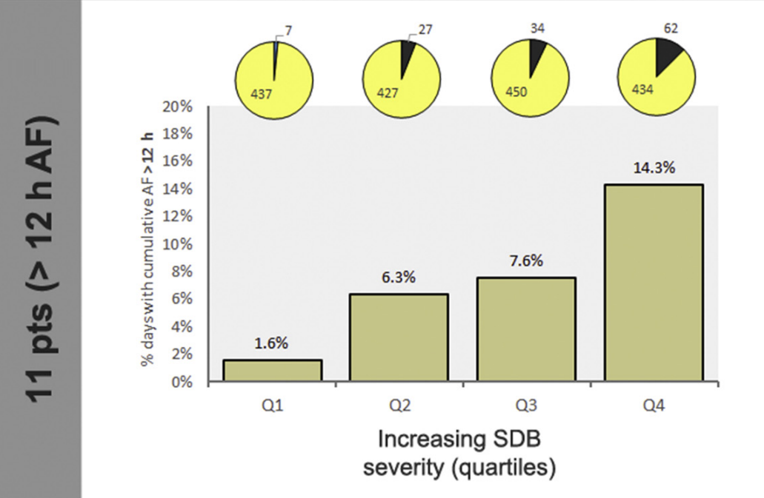
Sleep Disordered Breathing and Days with Atrial Fibrillation
Percentage of days with at least >5 min, >1 h, and >12 h of AF for each within-patient quartile (Q1 to 4) of SDB severity, assessed by nightly RDI. Pie chart black sections indicate days with at least >5 min, >1 h, and >12 h of AF; yellow sections indicate days without at least >5 min, >1 h, and >12 h of AF
Linz, et al. Am Coll Card EP 2019;5:692–701

Slide 6
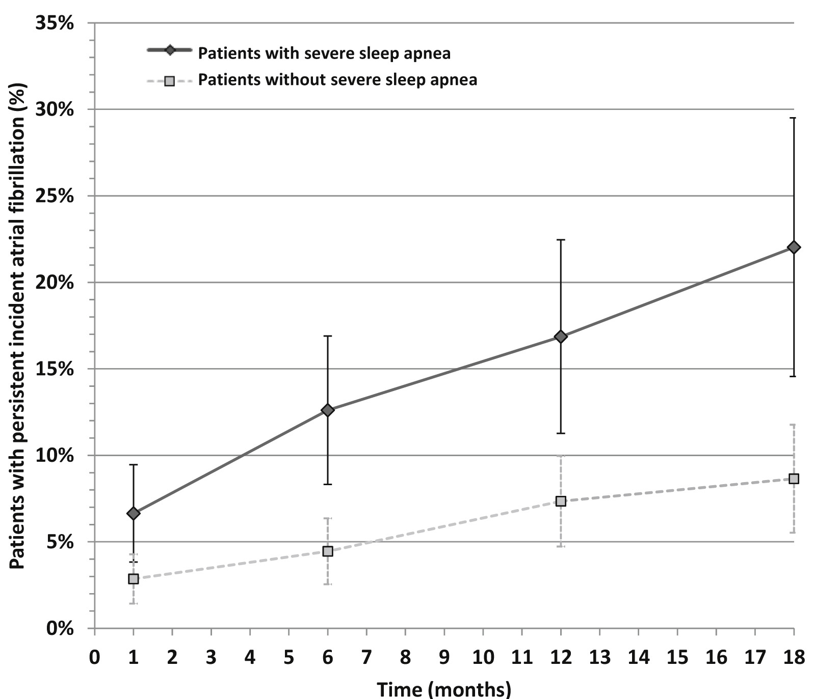
Sleep Apnea Predicts Atrial Fibrillation
Figure 3
Data from REVIVE pacemaker study
CI 3.7-18.4%
Heart Rhythm 2020 17195-202DOI: (10.1016/j.hrthm.2019.09.001)
Notes:
Identification of persistent AF (AF episode lasting >7 days) over time in patients with or without severe sleep apnea in the modified intention-to-treat population. AF = atrial fibrillation.

Slide 7
Much lower rates of Afib after cardioversion for patients that continued PAP treatment at 1 year
Adapted from Grigoriu et al. Pneumologia; 69, 2020

Slide 8
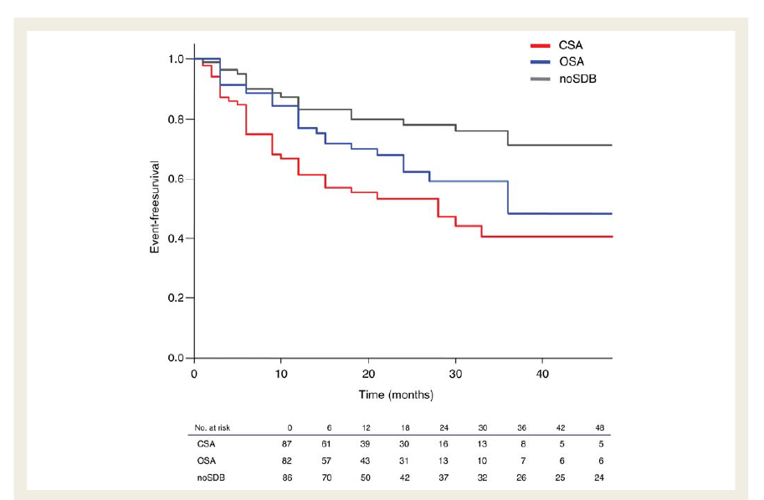
Sleep Apnea Predicts Appropriate ICD Therapies
Kaplan–Meier plot on appropriate cardioverter-defibrillator therapies
Bitter et al. European Heart Journal, 2011;32: 61–74,

Slide 9
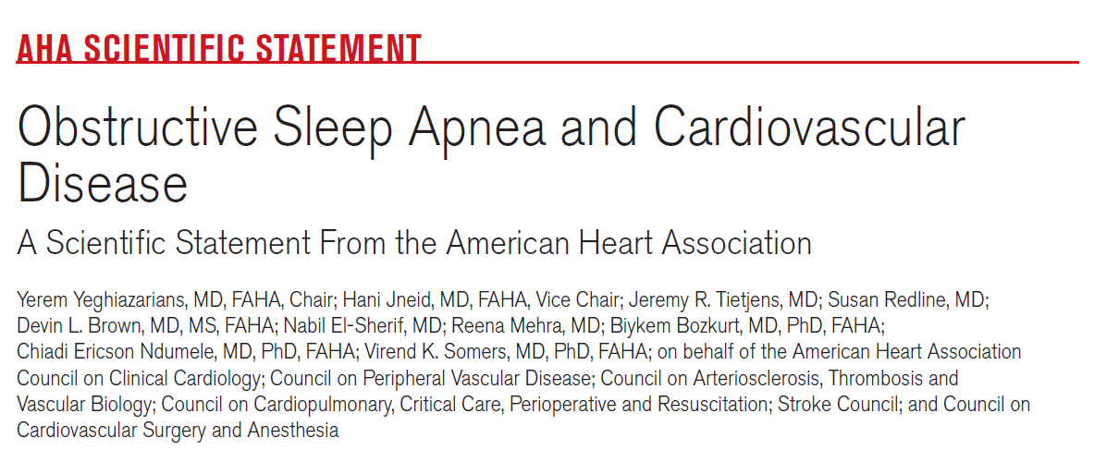
From the following centers: UCSF, Baylor, Houston VA, U Mich, Downstate Medical Center, Cleveland Clinic, Hopkins, Brigham and Womens, Mayo Rochester
AHA Scientific Statement OSA and CVD 2021

Slide 10
Recommendations for Screening for Obstructive Sleep Apnea
Screen for OSA | Consider sleep study if concerning signs/symptoms of sleep apnea are present
Resistant/poorly controlled hypertension | NYHA class II – IV HF symptoms
Pulmonary hypertension | Tachy-brady syndrome
Recurrent atrial fibrillation (after either cardioversion or ablation) | Sick sinus syndrome
 | Ventricular tachycardia
 | Survivors of sudden cardiac death
 | Stroke
Adapted from AHA Scientific Statement OSA and CVD 2021

Slide 11
Agenda
Sleep Apnea and Cardiovascular Disease
Central Sleep Apnea Background
The remedē® System Therapy
Clinical Results

Slide 12
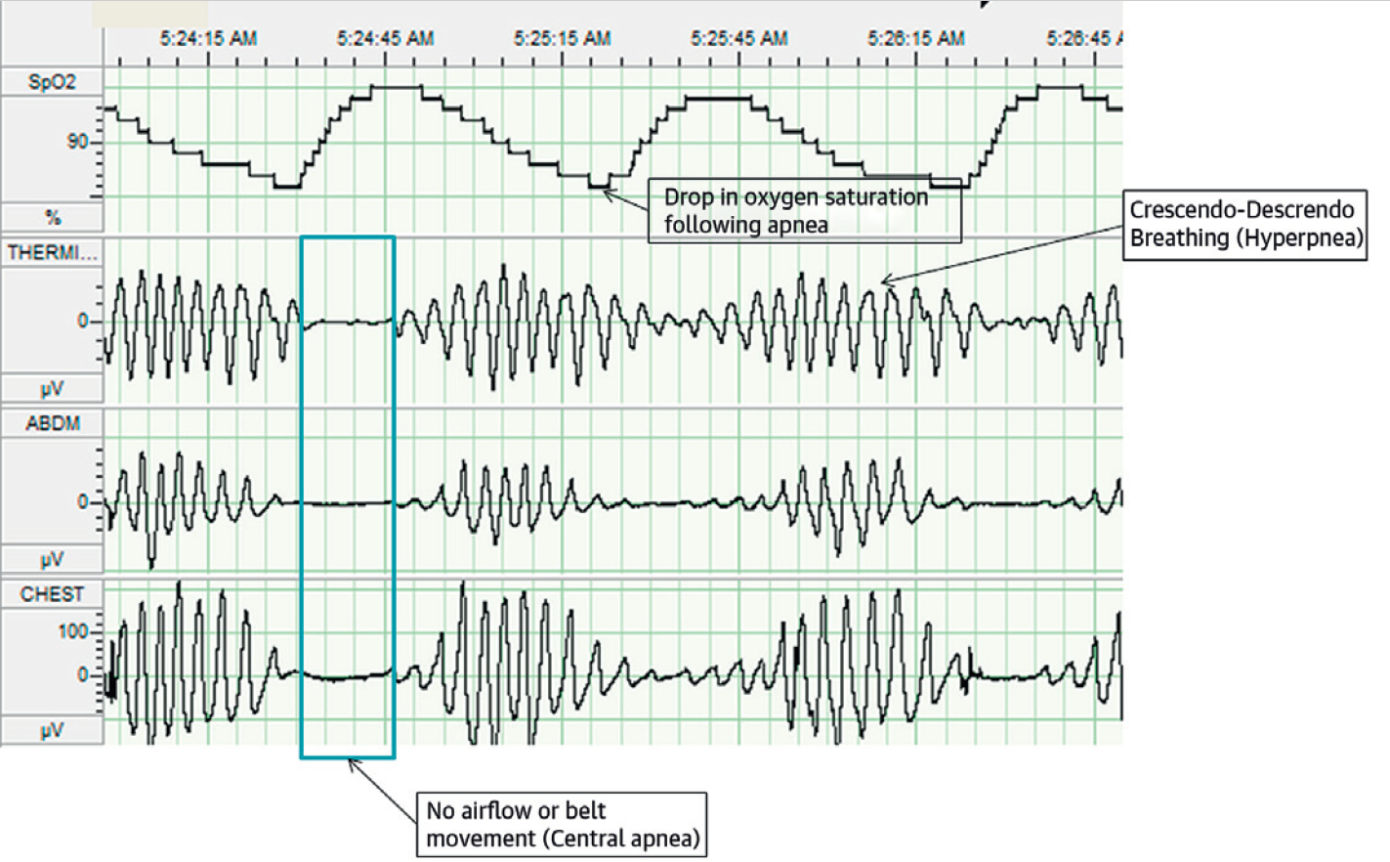
Central Sleep Apnea
Central sleep apnea results from an intermittent neural drive to breathe
Patients with co-morbidities such as heart failure, atrial fibrillation and renal disease are at increased risk for CSA
Costanzo, et al. J Am Coll Cardiol 2015;65:72–84.
Notes:
Central sleep apnea is a form of sleep disordered breathing which results from an intermittent neural drive to breathe. It primarily occurs in diseases associated with increased sympathetic drive such as heart failure, atrial fibrillation and renal disease. The bottom panel on this slide shows CSA during a sleep study demonstrating a period of rapid, deep breathing (hyperpnea) followed by periods of absent (apnea) or shallow breathing (hypopnea). CSA is characterized by an absence of movement of the thoracic and abdominal belts indicating no attempt at breathing during these episodes. Each apneic or hypopneic episode results in an arousal and a decrease in oxygen saturation.

Slide 13
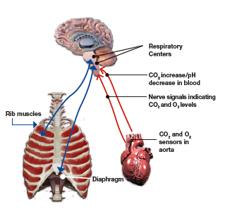
Pathophysiology of Central Sleep Apnea
During sleep, respiration is regulated by the brain whose goal is to maintain a constant blood CO₂
To keep CO₂ regulated, the brain sends signals to the diaphragm via phrenic nerves. These signals control the pattern of breathing
In patients with central sleep apnea, the brain develops a respiratory arrhythmia that manifests as an oscillating pattern between hyperventilation and apnea
Phrenic Nerves
Dempsey et al. Physiol Rev 2010; 90:47-112
Orr et al. Respirology 2017; 22, 43–52
Notes:
During sleep, respiration is regulated by the respiratory control center in the brain to maintain a constant carbon dioxide level in the blood. When carbon dioxide levels rise, signals are sent to the muscles of respiration to breathe. The largest breathing muscle is the diaphragm which receives its signal via the phrenic nerve. In CSA, there is a delay in the signaling process which produces a respiratory arrhythmia leading to an oscillation between hyperventilation and apnea.
One form of this patterned breathing, Cheyne-Stokes Respiration, can be seen during the daytime in patients with heart failure. However, patients with very mild heart failure and without heart failure can be found to have this pattern at nigth.

Slide 14
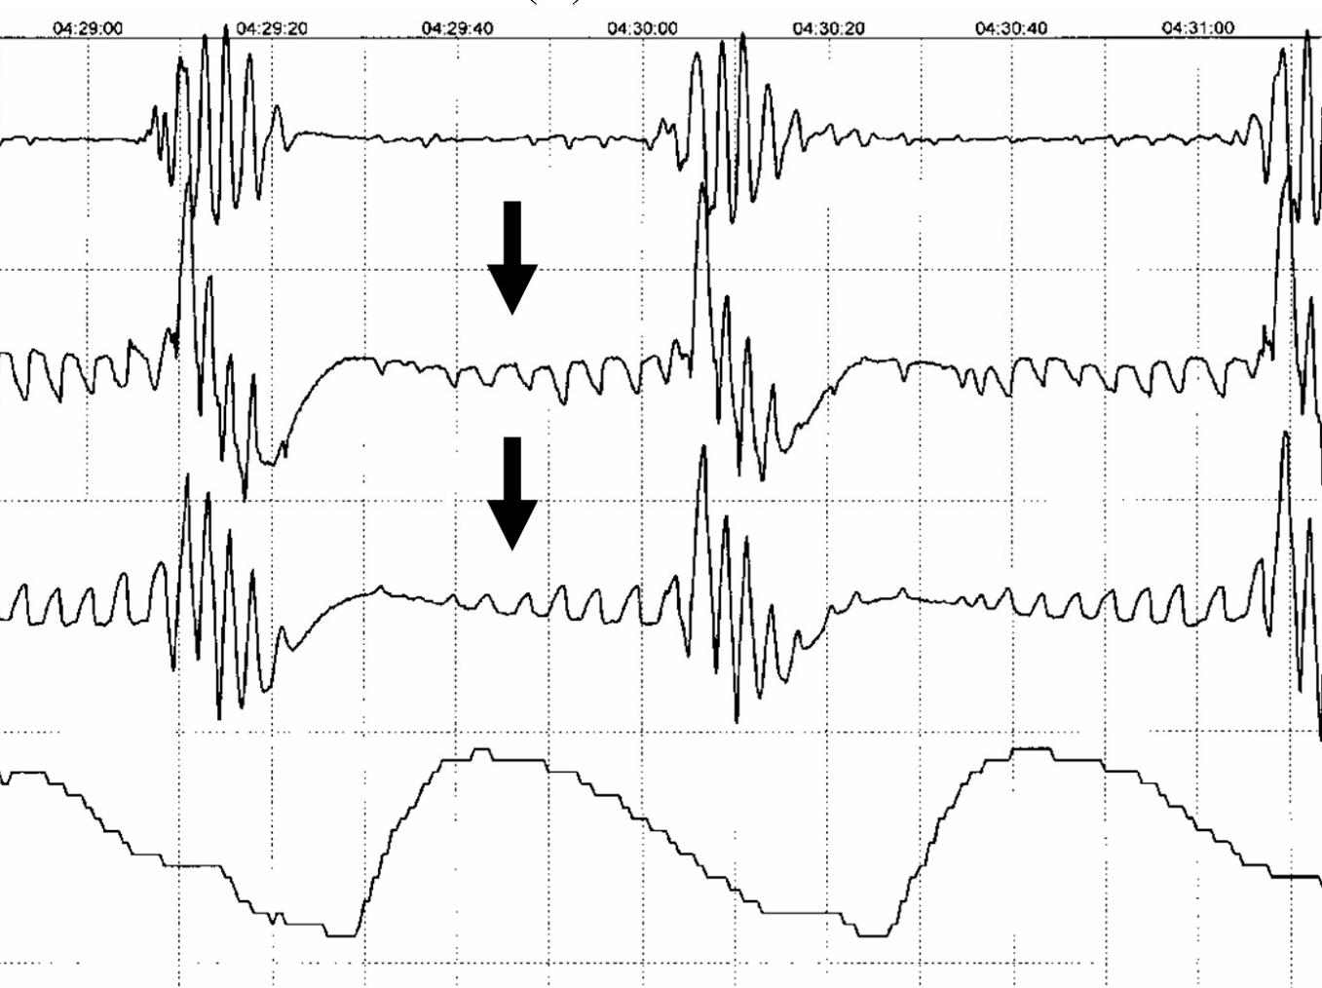
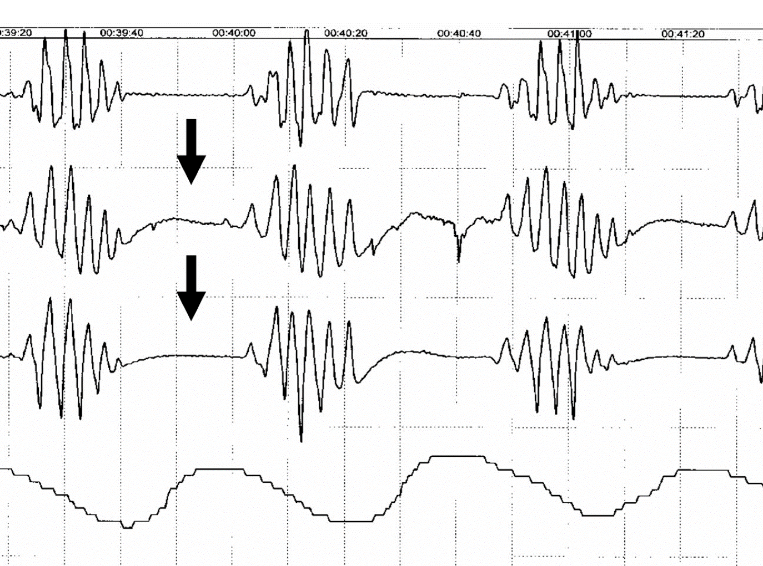
The Difference Between OSA and CSA is Evident in Sleep Studies
Obstructive Sleep Apnea
Central Sleep Apnea
Nasal Flow
Abdomen
Effort
Thorax
90
90
SpO_{2 (%)}
80
80
70
70
Abdomen moves as a breath is attempted
Airflow blocked or reduced due to obstruction, resulting in oxygen desaturation
Abdomen does not move; no breath attempted
Limited or no airflow due to lack of attempted breath, resulting in oxygen desaturation
Pham, et al High Alt Med Biol 2017; 18: 11-19

Slide 15
Most Patients with CSA also have Concomitant Cardiovascular Conditions
Heart Failure^{2,3}
CSA occurs in 30–50% of patients with heart failure with reduced left ventricular ejection fraction (LVEF) and in 18–30% of HF patients with preserved LVEF
70%+ of CSA patients have heart failure and/or reduced left ventricular ejection fraction (LVEF)
Atrial Fibrillation^{2,4,5}
CSA occurs in 10-30% of patients with atrial fibrillation
20+% of CSA patients have atrial fibrillation
Etiology of Central Sleep Apnea^{1,2}
Javaheri and Dempsey, Comprehensive Physiology 2013;3:141-163;
Dymedex data on file, 2014.;
Bekfani and Abraham, Europace 2016; 18:1123-24;
Tung et al. J Am Heart Assoc. 2017;6:e004500. DOI: 10.1161/JAHA.116.004500
Bitter T, et. al. Dtsch Arztebl Int. 2009;106(10):164–170.

Slide 16
Sleep Disordered Breathing is Common in Heart Failure Untreated CSA symptoms can overlap HF symptoms
Many patients with CSA complain of symptoms which may be multifactorial:
Fatigue
Low cardiac index
Medication side-effects
Depression
Co-existent medical problems
Frequent hospitalizations
Nocturia
Frequent awakenings
CSA patients often have apneas observed by bed partners
CSA patients frequently do not snore
CSA patients frequently are not aware that they have arousals
Roger et al. Circulation 2011;123:e18-209
Oldenburg et al. Eur J Heart Fail;20079:251-7
Costanzo et al., JACC 2015; 65(1):72-84
Arzt et al., JACC: Heart Fail 2016; 4(2):116-125
Notes:
Many patients with CSA have a primary complaint of daytime “fatigue” or “tiredness”
Fatigue may be multifactorial in these patients
Low cardiac index
Medication side-effects
Co-existent medical problems (depression, anemia, etc.)
Sleep disorders
Despite optimal medical therapy, many patients continue to complain of significant fatigue
CSA patients frequently do not snore
CSA patients frequently are not aware that they have arousals

Slide 17
Screening Patients for Sleep Disordered Breathing
The use of screening tools may help identify who needs a sleep study:
Epworth Sleepiness Score
STOP-BANG (>3)
Generic tool to assess for fatigue, apneas, etc.
Think about SDB when patients report:
Ongoing fatigue despite medical mgt and HF stability
Excessive Nocturia
Frequent awakenings
Recurrent hospitalizations
For every 10 heart failure patients…
>7 of them will have
some form of SDB
When to Screen:
First HF patient visit
Post-discharge follow up visits
In office within 7-10 days of discharge from a HF-related admission
During admission
Avg HF admission is 4-5 days
Screening with ODI or HSAT near end of visit
~ 4 of them will have Obstructive Sleep Apnea
~ 4 of them will have
Central Sleep Apnea
Labarca et al. Sleep Medicine 2019; 61: 82-87
Costanzo et al., JACC 2015; 65(1):72-84
Arzt et al., JACC: Heart Fail 2016; 4(2):116-125
Oldenburg et al. Eur J Heart Fail; 2007; 9:251-7
Notes:
Many patients with CSA have a primary complaint of daytime “fatigue” or “tiredness”
Fatigue may be multifactorial in these patients
Low cardiac index
Medication side-effects
Co-existent medical problems (depression, anemia, etc.)
Sleep disorders
Despite optimal medical therapy, many patients continue to complain of significant fatigue
CSA patients frequently do not snore
CSA patients frequently are not aware that they have arousals

Slide 18
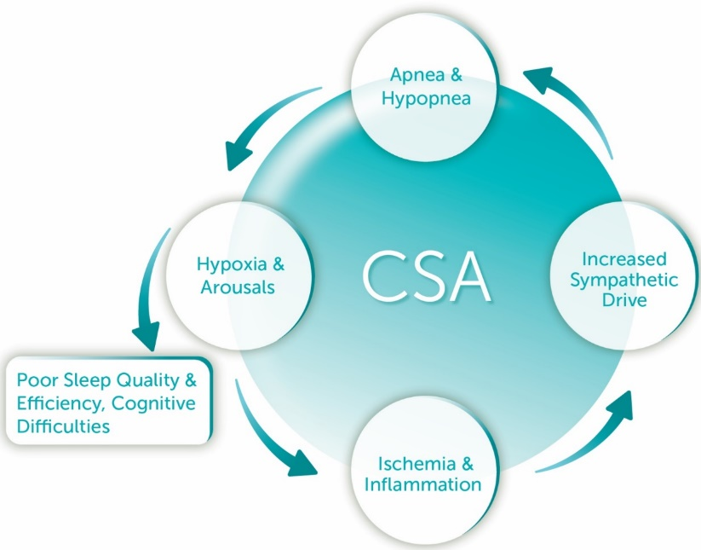
Untreated CSA causes life altering levels of fatigue as well as increased health risks for patients with heart failure and atrial fibrillation
CSA is due to a loss of neural drive to breathe during sleep¹
Nighttime sleep disruptions significantly diminish quality of life^{2,3,4,5}
Untreated CSA significantly increases health risks for these patients
Severe fatigue
Excessive daytime sleepiness
Cognitive impairment
Depression
Memory deficits
Significantly higher rates of heart failure and atrial fibrillation^{1,6}
2x more likely to have a HF-related readmission within 6 months⁷
2x the mortality rate in HF patients⁸
Untreated CSA increases health risks
CSA patients undergo hundreds of repeated cycles of oxygen desaturation, arousals and surges in sympathetic drive
CSA patients often go untreated due to few scientifically proven, FDA-approved therapeutic options
Bekfani and Abraham, Europace 2016; 18:1123-24
Dempsey JA. Exp Physiol 2005; 90: 13–24,
Javaheri S., Dempsey J.A. Compr Physiol. 2013; 3:141–163
Brenner, S., et al. Trends Cardiovasc. Med. 2008; 18, 240–247.
Flemons WW, Tsai W. J Allergy Clin Immunol 1997; 99:S750-S756
Tung et al. J Am Heart Assoc. 2017; e004500. DOI: 10.1161/JAHA.116.004500.
Khayat et al. J Card Fail 2012; 18:534-540.
Khayat et al. Eur Heart J 2015; 23:1463-1469.
Notes:
This slide may not be necessary for (or understood by) techs, MAs, etc. This will resonate with cardiology/HF providers.
Key messages:
+ Majority of CSA patients have HF (75-80%), but there are a significant amount that do not
+ CSA increases readmissions, mortality, risk of comorbidities…also patients are highly symptomatic

Slide 19
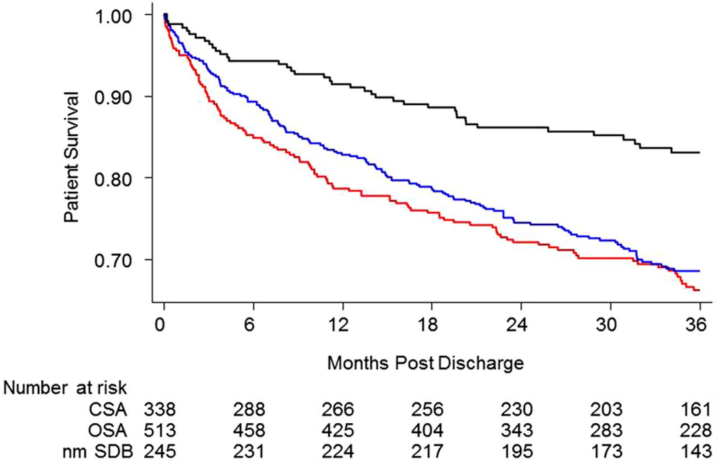
Sleep Disordered Breathing is a Predictor of Mortality in HF Patients
Survival – Heart failure (LVEF< 45%) with CSA patients vs. heart failure with normal breathing in NIH sponsored study
HF combined with CSA is associated with a 2-fold increase in risk of death
No or minimal (nm) SDB
OSA
Hazard ratios
CSA vs. no or minimal SDB | OSA vs. no or minimal SDB
2.17 p < 0.001 | 2.00 p < 0.001
CSA
Khayat et al. Eur Heart J 2015; 36:1463-9

Slide 20
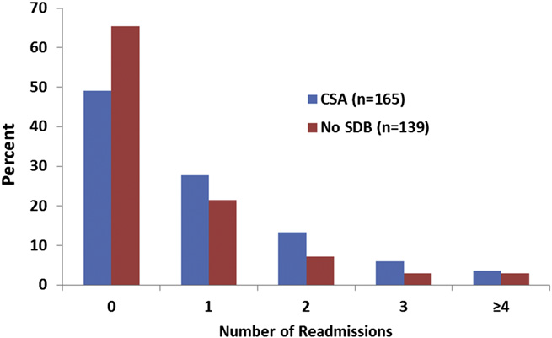
Central Sleep Apnea Increases the Risk of Heart Failure Readmission
Heart failure readmissions within 6 months – CSA population vs. patients free of sleep disordered breathing (SDB) in NIH sponsored study
Percent of patients
Central Sleep Apnea (n=165)
No Sleep Disordered Breathing (n=139)
>50% of CSA Patients
Hazard ratios
CSA vs. no SDB
1.63, p = 0.01
>25% of CSA Patients
50% of HF patients with CSA were readmitted to the hospital at 6 months
Over 25% of heart failure patients with CSA had 2 or more hospital readmissions within 6 months
Khayat et al. J Card Fail 2012;18:534-540

Slide 21
Limited Treatment Options for Central Sleep Apnea
CPAP | Most common CSA treatment Clinical trials demonstrated improvement in AHI and EF CANPAP showed no improvement in QoL or M&M and was stopped early for safety Does not have a FDA approved indication to treat CSA
ASV (Adaptive servo-ventilation) | No clear results M&M: 2 large studies (n=1325 and n=758) both neutral (one showed harm in low EF patients) Showed and improvement in AHI but no improvement in QoL Still has a black box warning and Class III recommendation against use in patients with EF < 45%
Oxygen Therapy | Small randomized studies show improvement in AHI, but no improvements in arousals or daytime sleepiness Does not have a FDA approved indication to treat CSA
Medications Acetazolamide Theophylline Buspirone | Studied in short (<3 month) studies with < 20 patients Does not have a FDA approved indication to treat CSA Buspirone only studied in 8 patients for 2 weeks currently
Aurora et al., SLEEP 2012;35:17-40; Costanzo, et al., JACC 2015; 65: 72-84; Sepehrvand, et al. JACC 2016; 4: 783-790. Bradley TD, et al. N Engl J Med 2005;353:2025-33; Cowie MR et al. New Engl J Med 2015; 373:1095-1105. Aurora et al. J Clin Sleep Med 2016; 12:757-761

Slide 22
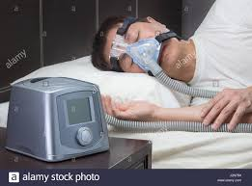
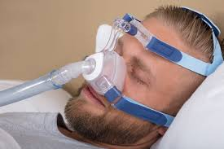
Positive Airway Pressure (PAP) Devices were Designed to Treat OSA In CSA, PAP has limited effectiveness data, compliance and tolerance issues
Positive airway pressure therapies have been shown to reduce AHI but have not shown improvements in arousals, REM Sleep or quality of life in a randomized clinical trial¹
Many patients are unable to tolerate PAP due to a range of challenges:²
Mask discomfort
Mask leakage
Pressure intolerance
Skin Irritation
Nasal congestion
25-50% of patients refuse or are unable to tolerate these therapies^{3,4}
40-60% are non-compliant to even a minimal bar of 4 hours/night, 5 nights/week.^{3,4}
Randomized clinical trials have also revealed safety concerns for PAP therapies in patients with reduced left ventricular ejection fraction (LVEF) ⁵
Nasal drying
Nosebleeds
Claustrophobia
Bed partner disruption
Challenge to intimacy
Bradley TD, et al. N Engl J Med 2005;353:2025-33
https://www.mayoclinic.org/diseases-conditions/sleep-apnea/in-depth/cpap/art-20044164
Takama N, Kurabayashi M, Circulation Journal 2012;76:661-7
Arzt M, et al., Circulation 2007; 115:3713-80
Cowie MR et al. New Engl J Med 2015; 373:1095-1105

Slide 23
Agenda
Sleep Apnea and Cardiovascular Disease
Central Sleep Apnea Background
The remedē® System Therapy
Clinical Trial Results

Slide 24
The remedē® System brief statement
Indications for Use
The remedē® System is indicated for moderate to severe Central Sleep Apnea in adult patients.
Your doctor will need to evaluate your condition to determine if the remedē system is right for you. The remedē system is MR Conditional but conditions apply. Please make sure that your physician knows about the conditions and precautions to ensure safety, which can be found in the remedē system MRI guidelines manual. You should not have the remedē System implanted if you have an infection and you will not be able to have diathermy (special heat therapies) after implantation. The remedē System may be used if you have another stimulation device such as a heart pacemaker or defibrillator; special testing will be needed to ensure the devices are not interacting.
As with any surgically implanted device, there are risks related to the surgical procedure itself which may include, but are not limited to, pain, swelling, and infection.
Once the therapy is turned on, some patients may experience discomfort from stimulation and/or from the presence of the device. The majority of these events are resolved either on their own or by adjusting the therapy settings. The remedē system may not work for everyone. There are additional risks associated with removing your system. If you and your doctor decide to remove the system, another surgery will be required.
Be sure to talk with your doctor so that you thoroughly understand all of the risks and benefits associated with the implantation of the remedē System. Rx only. For further information, please visit remede.zoll.com, call +1-952-540-4470 or email info@remede.zoll.com.
The remedē® System, remedē® EL System, and remedē® EL-X System have received FDA approval. The remedē® System model 1001 has received CE Mark approval.
Copyright © 2021 ZOLL Medical Corporation. All rights reserved. Respicardia and remedē are registered trademarks of ZOLL Respicardia, Inc. in the United States and/or other countries. ZOLL is a registered trademark of ZOLL Medical Corporation in the United States and/or other countries.

Slide 25
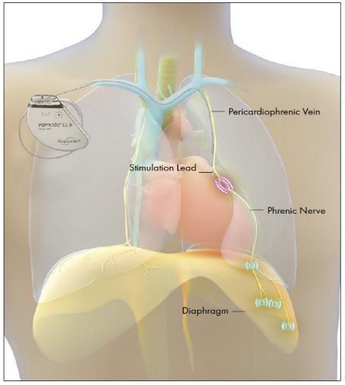
Transvenous Phrenic Nerve Stimulation with the remedē® System
Fully implantable system with an indication to treat moderate to severe central sleep apnea in adults; received U.S. FDA PMA approval October 2017
Stabilizes breathing by activating the diaphragm to generate negative pressure in the chest (similar to natural breathing)
Turns on automatically at night, ensuring nightly compliance and adherence over time
Implanted by cardiac electrophysiologists (EPs)
Pulse generator implanted below clavicle
Stimulation lead placed either in left pericardiophrenic or right brachiocephalic vein
Sensing lead placed in the Azygos vein, helps optimize therapy (optional)
Diaphragm
FDA-Approved Summary of Safety and Effectiveness Data (SSED) for the remedē® System and The remedē System Implant and Clinician Use Manual (P160039) Oct. 6, 2017.

Slide 26
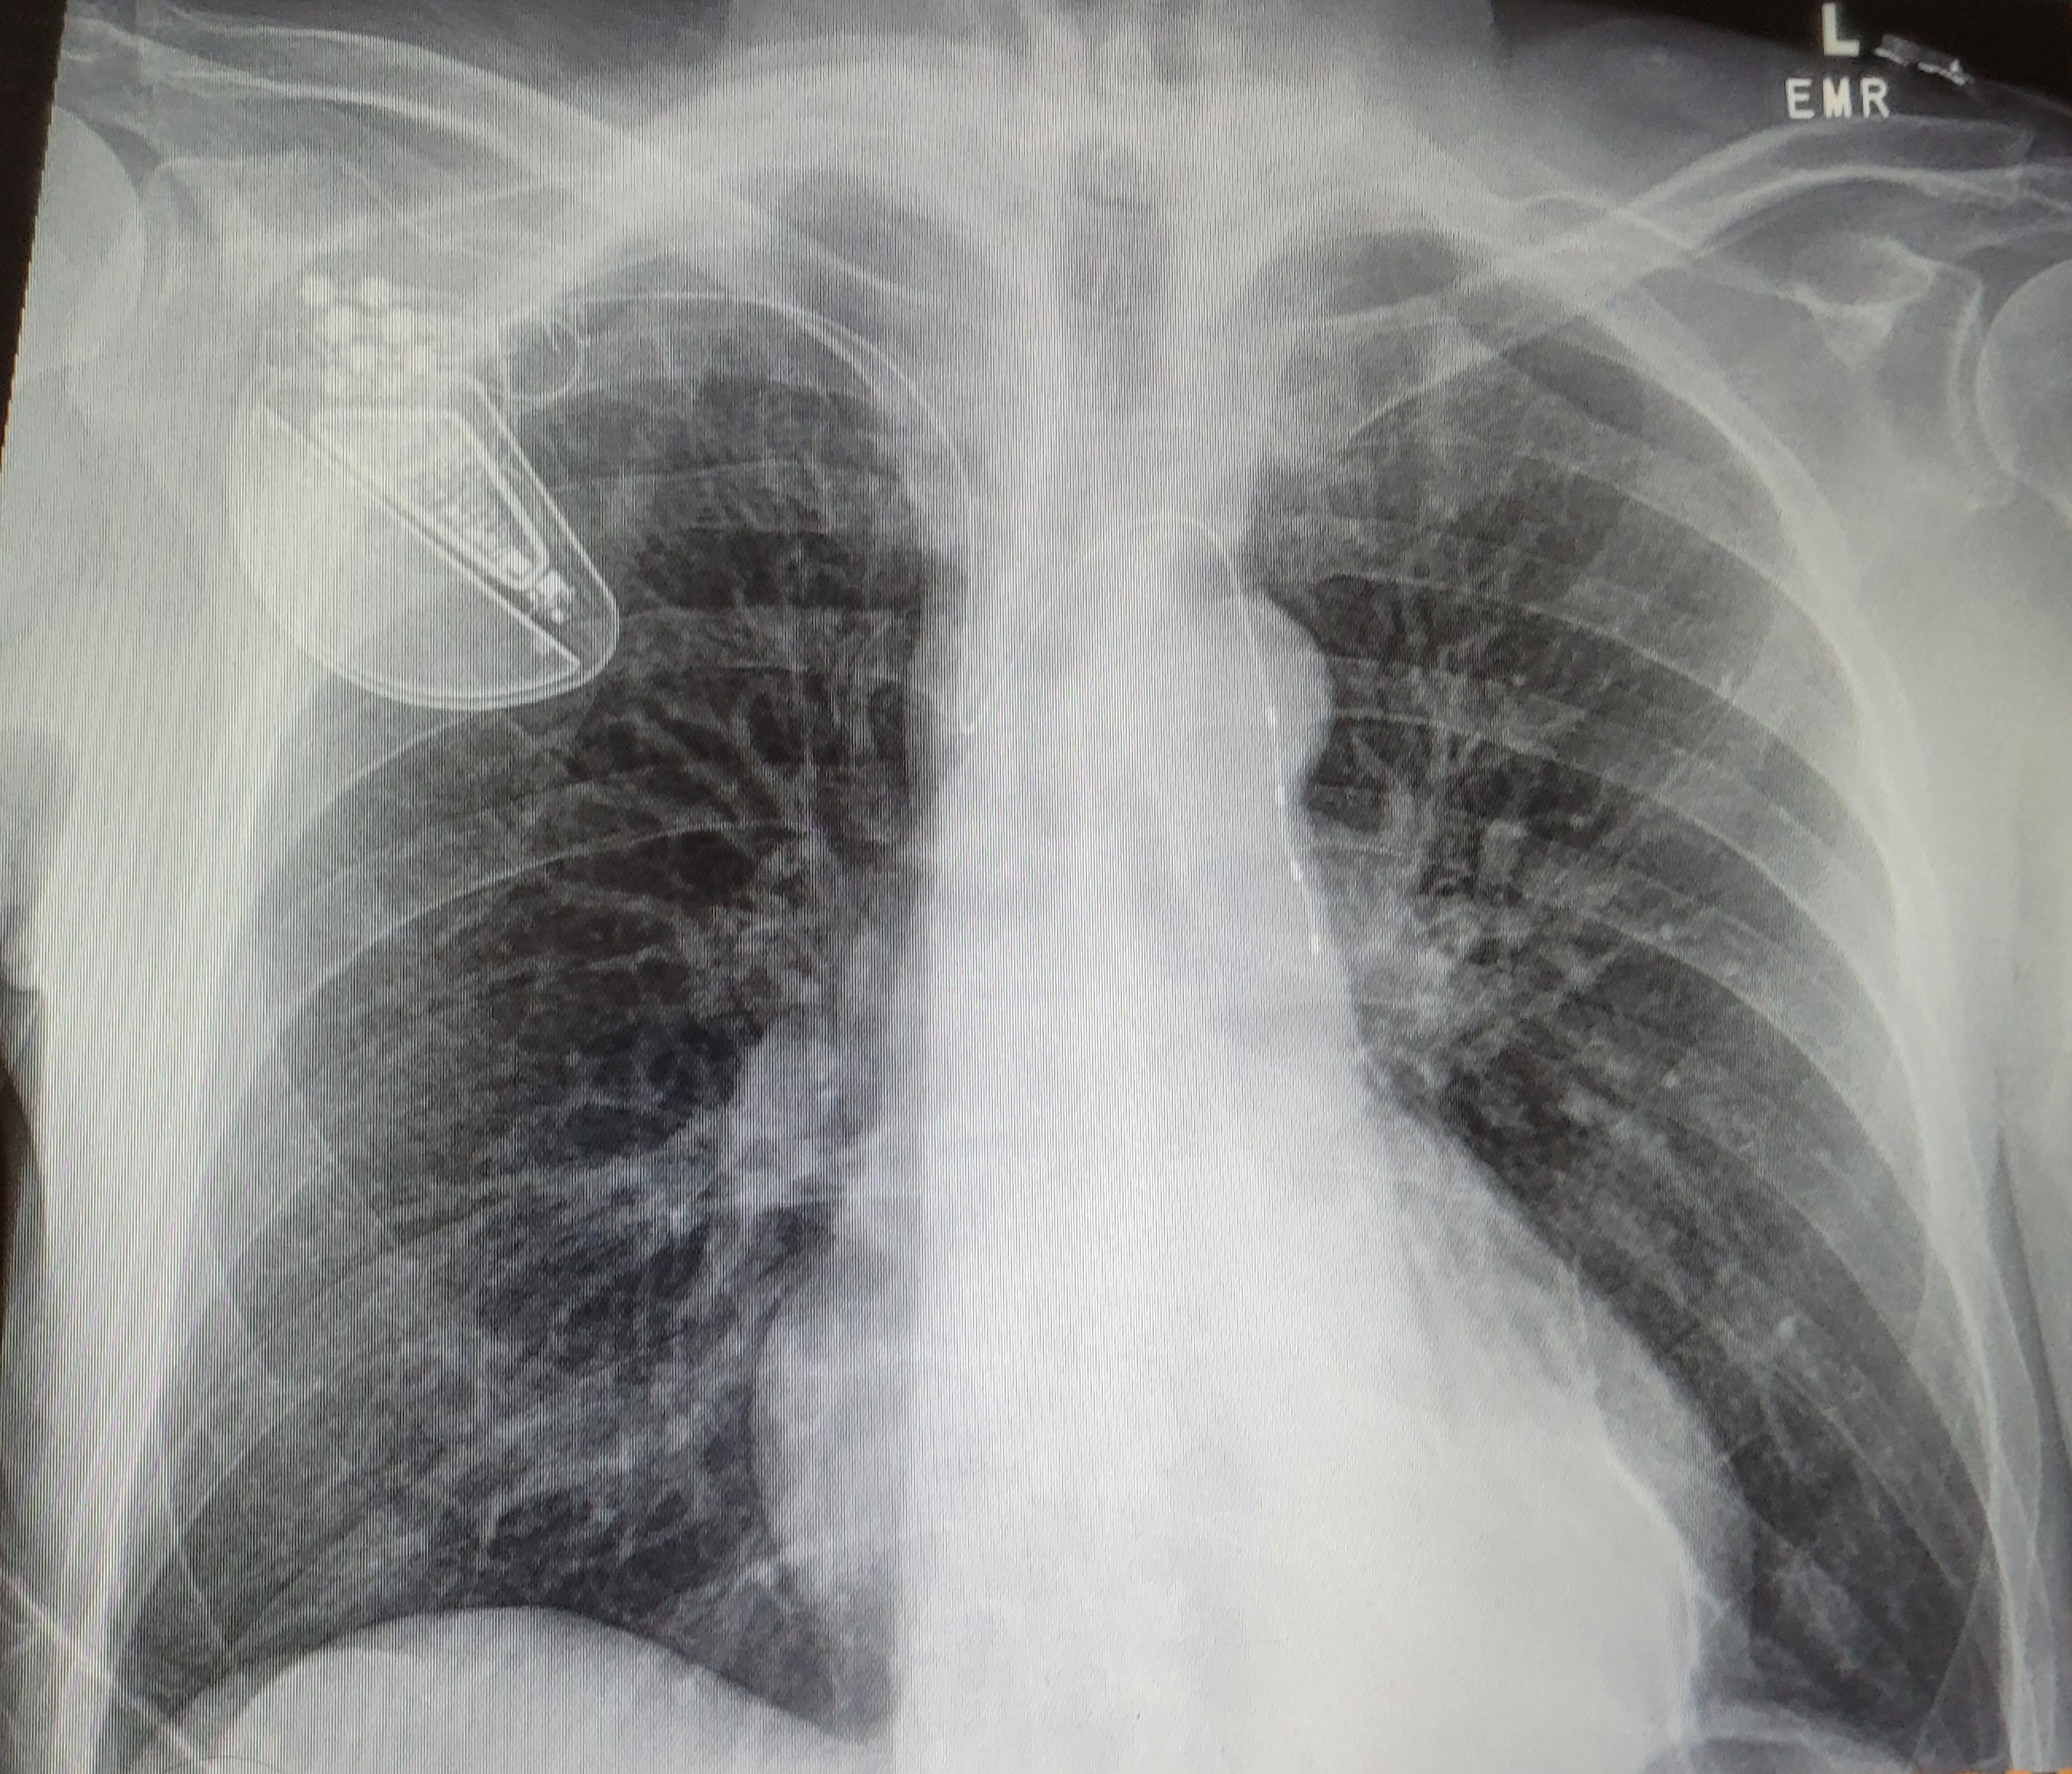
The remedē® EL System
remedē EL System
Stimulation Lead

Slide 27
remedē® System Therapy Activates Automatically Each Night
Therapy is Delivered When…
It is within the pre-programmed sleeping hours…
…AND the patient is reclined past the programmed sleeping angle…
…AND the patient is not moving
Example
11:00 pm
Therapy is Paused When…
The patient sits up…
…OR the patient moves
Therapy resumes ~10 minutes after the patient returns to sleep position and is once again still

Slide 28
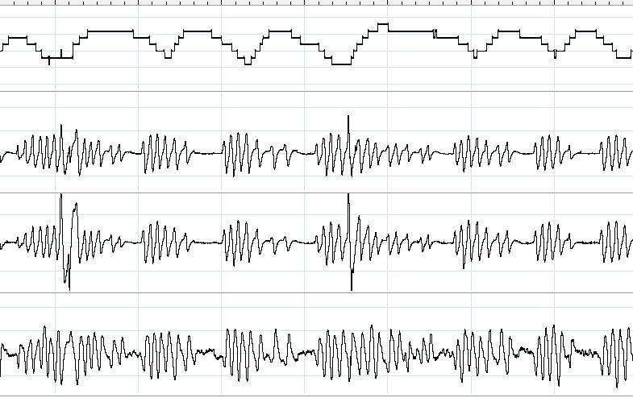
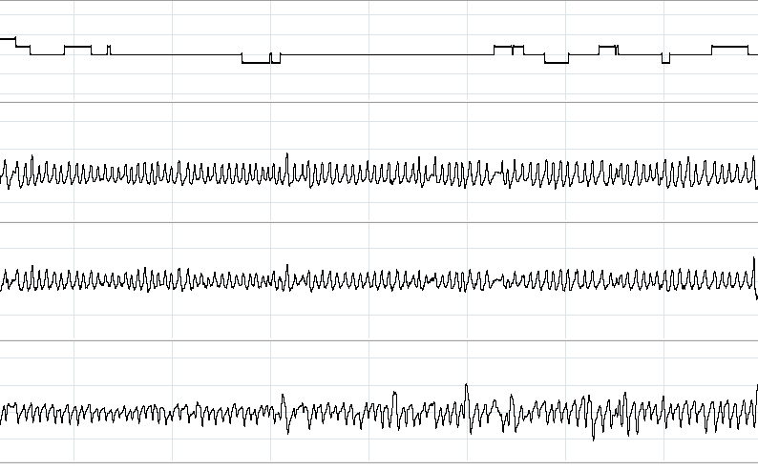
Breathing stabilizes and apnea events are significantly reduced when phrenic nerve simulation is being delivered in this example¹
1 min intervals
Oxygen stabilizes
Oxygen
Saturation
Central apnea events
Abdominal Belt
Thorax Belt
Airflow
Therapy Off
Therapy On
*This is an individual patient example and does not provide any indication, guide, warranty or guarantee as to the response other patients may have to the therapy.
1 Costanzo MR, et al., J Card Fail. 2015;21:892-902

Slide 29
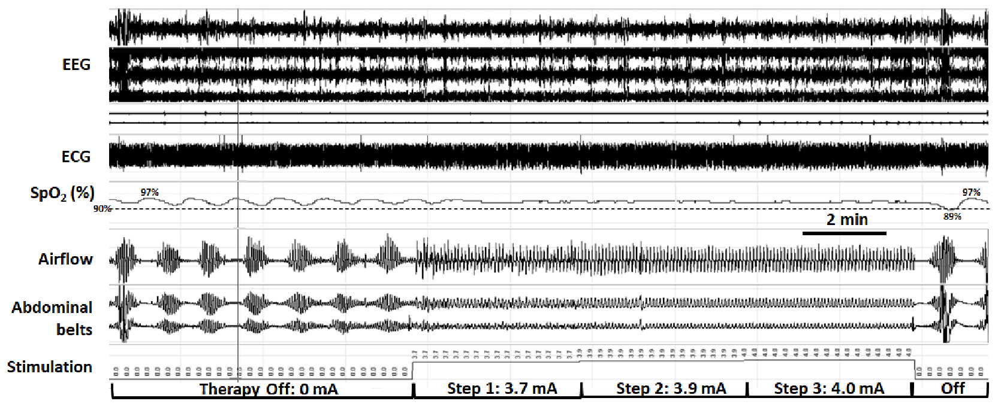
TPNS Utilizes a Step-wise Increase in Stimulation to Capture Ventilation and Stabilize the Breathing Pattern
Automatic step-wise increases in stimulation amplitude stabilize tidal airflow, respiratory effort and oxyhemoglobin saturation as ventilation is captured progressively
A period of step-wise increases in phrenic nerve stimulation amplitude (middle segment) is bracketed by periods off stimulation. Automatic step-wise increases in stimulation amplitude stabilize tidal airflow, respiratory effort and oxyhemoglobin saturation as ventilation is captured progressively.
*This is an individual patient example and does not provide any indication, guide, warranty or guarantee as to the response other patients may have to the therapy.
Schwartz AR, et al. J Clin Sleep Med. 2020;16(5):817–820.

Slide 30
remedē® System Therapy Programming and Follow-up
~1-month post-implant
1-3 months
Every 3-6 months
Therapy Initiation
Acclimation / Therapy Titration
Long-Term Follow-Up
Therapy is activated ~ 1 month post implant during a follow-up office visit
Patient acclimation period as therapy is customized to maximize efficacy while maintaining patient comfort
Programming checks every 3-6 months to optimize therapy. Physician may order a sleep study to help optimize.
Courtesy Respicardia, Inc

Slide 31
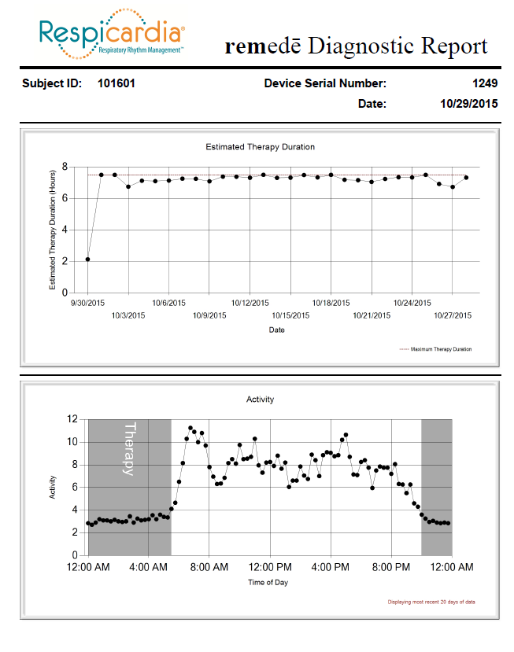
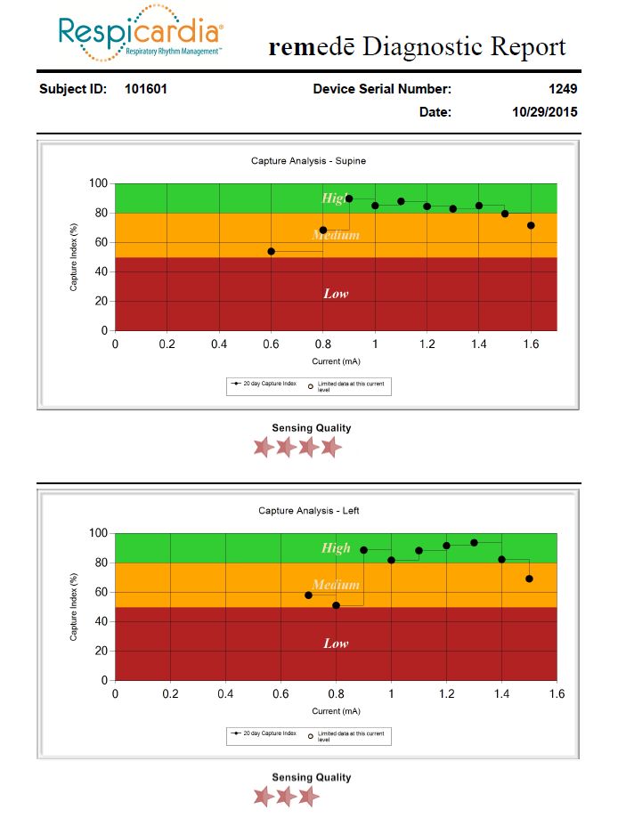
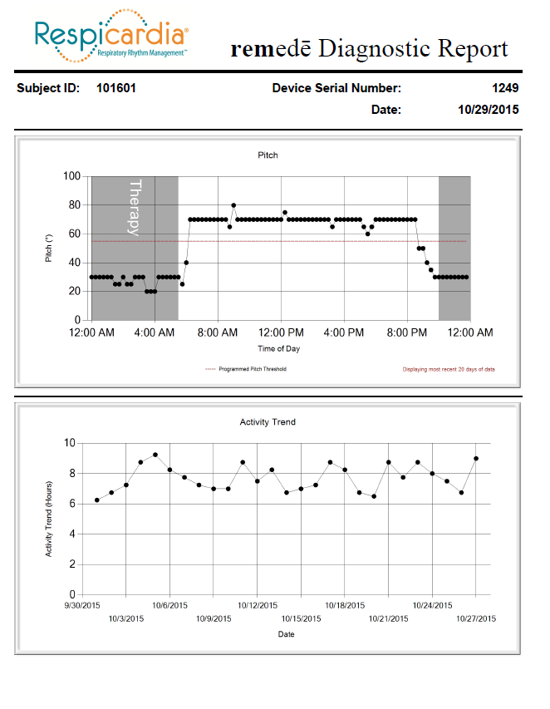
remedē® System Reports Provide Programming Guidance
Therapy timing and sleeping posture (horizontal position)
Activity trends
Therapy Duration
Daily Activity (naps, afternoon activity)
Capture Index by Position
Courtesy Respicardia, Inc

Slide 32
Agenda
Sleep Apnea and Cardiovascular Disease
Central Sleep Apnea Background
The remedē® System Therapy
Clinical Trial Results

Slide 33
The remedē® System Pivotal Trial Study design
Prospective, multi-center, randomized controlled trial
Baseline criteria for moderate to severe CSA was based on PSGs scored by a blinded core laboratory
AHI ≥ 20
CAI at least 50% of all apneas with at least 30 central apnea events
Obstructive Apnea Index ≤ 20% of the total AHI
ENDPOINT | DESCRIPTION | POPULATION
Primary Effectiveness (6 months) | Comparison of the proportion of subjects with ≥50% reduction in AHI between treatment and control | Intention to Treat (ITT)
Primary Safety (12 months) | Freedom from serious adverse events associated with implant, the remedē system, or delivered therapy | Intention to Treat
Secondary Hierarchical (6 months) | Central Apnea Index (CAI) Apnea Hypopnea Index (AHI) Arousal Index (ArI) Rapid Eye Movement (REM) Patient Global Assessment (PGA) Oxygen Desaturation Index 4% (ODI4) Epworth Sleepiness Scale (ESS) | Per-protocol
Costanzo MR, et al., J Card Fail. 2015;21:892-902.
33

Slide 34
In the pivotal RCT, the remedē System demonstrated clinically meaningful improvements in sleep, sleep apnea and quality of life
Change from baseline
Between group difference
Endpoint Met?
Endpoint
Treatment
Control
Difference
p-value
Primary endpoint
(n= 141⁵)
Yes
>50% reduction in AHI¹
51%
11%
41%
<.0001^{Δ}
CAI (events/hr)
Central Apnea Index
-25.7 ± 18.0
-2.9 ± 17.7
-22.8 ± 17.8
<.0001†
Yes
AHI (events/hr)
Apnea Hypopnea Index
-23.9 ± 18.6
1.1 ± 17.6
-25.0 ± 18.1
<.0001‡
Yes
ArI (events/hr)
Arousals
-20.2 ± 18.9
-5.0 ± 18.1
-15.2 ± 18.5
<.0001‡
Yes
Secondary endpoints
(n= 131⁵)
% of sleep in REM
1.8 ± 8.2
-0.6 ± 7.8
2.4 ± 7.9
.0244†
Yes
QOL – PGA²
% patients w/ marked or moderate improvement
60%
6%
55%
<.0001^{Δ}
Yes
ODI4 (events/hour)
O2 Desaturation 4% below baseline
-19.1 ± 18.4
3.6 ± 17.3
-22.7 ± 17.8
<.0001†
Yes
QOL – ESS³
Epworth Sleepiness Score
-3.6 ± 5.6
+0.1± 4.5
-3.7 ± 5.0
<.0001†
Yes
Safety
91% (CI: 86%,95%) freedom from serious adverse events associated with the implant procedure, device,
or the delivered therapy at 12 months
Primary endpoint is the proportion of subjects achieving ≥50% reduction in AHI
PGA = Patient global assessment
ESS = Epworth Sleepiness Scale, an 8-question assessment used to assess sleepiness
For primary endpoint, n=68 for treatment and n=73 for control; for secondary endpoints, n=58 for treatment and n=73 for control
Costanzo et al. Lancet 2016;388:974-82; Goldberg L et al. J Cardiac Fail 2017;23:S15.
Δ Fisher’s Exact Test.
† Mann-Whitney test for difference in change from baseline between groups.
‡ t-test for difference in change from baseline between groups.

Slide 35
PSG Results at 24 months of Therapy Demonstrated Effective and Durable Results
remedē AHI reduction ¹
Median events/hr
Total AHI at baseline = 49*
Total AHI at 24 months = 16*
2.1
Obstructive apnea
1.2
Mixed apnea
p<0.001 for paired change from baseline
Hypopnea
Central apnea
-67%
Potential reasons for residual events
Obstructive events
Incomplete ventilatory capture during therapy adjustment
0.0
0.2
Baseline (n=58)
24 months (n=42)
* Total median AHI does not sum from component medians
Notes:
Residual events: (1) obstructive events, (2) not fully capturing ventilation

Slide 36
Sustained Improvement in Sleep Disordered Breathing Through 5 Years with TPNS
Late Breaking Clinical Trial Presentation
Apnea Hypopnea Index
Paired at 5 years
Note: Sum of component medians does not add up to AHI.
Median change [IQR]: -22 [-42, -7] P<.001
Javaheri, S CHEST 2020 Late Breaking Abstracts DOI: https://doi.org/10.1016/j.chest.2020.09.011

Slide 37
Sustained Improvement in Sleep Architecture Through 5 Years with TPNS
Shift away from light stage sleep (N1) to more deeper stage sleep (N2 - REM)
Paired at 5 years
Sleep Stages
Sleep Stages
Note: Sum of medians at a visit does not add up to 100%
Costanzo MR, Javaheri S, et al. Transvenous Phrenic Nerve Stimulation for Treatment of Central Sleep Apnea: Five-Year Safety and Efficacy Outcomes. Nat Sci Sleep. 2021;13:515-526
MAF1937 Rev E

Slide 38
Significant improvements in symptoms and quality of life after 6 months of treatment with TPNS¹
Improvement in Epworth Sleepiness Scale
Patient Global Assessment
Willingness to repeat procedure
p < 0.0001
Marked or moderate improvement
No change
Mild improvement
Worsened
Improved
6%
95%
Treatment (N=58)
Control
(N=73)
No change/worse
ESS Mean Change from Baseline (points)
[95% confidence interval]
Per Protocal Population * One patient did not complete the PGA assessment at 6 months.
>2.5 change in ESS is considered clinically meaningful²
Demonstrated clinically significant improvement in daytime sleepiness
79% of patients had an improvement in quality of life with the remedē System
95% of patients reported they would
“elect to have the medical procedure again”
Costanzo et al. Lancet 2016;388:974-82.
Patel S, Kon SSC, Nolan CM, et al. Am J Respir Crit Care Med. 2018;197(7):961–963

Slide 39
The remedē System pivotal trial demonstrated a strong safety profile
91% (CI: 86%,95%) freedom from serious adverse events associated with the implant procedure, the remedē® System, or the delivered therapy at 12 months
All related serious adverse events resolved without any long term sequelae
No deaths related to the procedure, system or therapy
97% implant success rate, including the 42% of subjects that already had a concomitant cardiac device
Costanzo MR, et al., The Lancet 2016;388:974–82.

Slide 40
Conclusions
Sleep apnea is a common comorbidity among patients with cardiovascular diseases, which if untreated can have significant negative impact on outcomes
Central Sleep Apnea contributes to a harmful progressive cycle of hypoxia, arousal and sympathetic activation
There have been few treatments for central sleep apnea and little randomized data demonstrating efficacy
Phrenic nerve stimulation offers a safe and effective therapeutic option for the treatment of CSA with improvements in both sleep and quality of life
Notes:
Central sleep apnea is a devastating disease with surges of neurohormonal activation negatively impacting cardiovascular health.
The remedē® System is a breakthrough technology demonstrated to be safe and effective in the treatment of adult patients with moderate to severe central sleep apnea.
Benefits to the remedē® System include improvements in oxygenation and arousals, normalizing the breathing pattern during sleep, ensured patient compliance and improved sleep and quality of life. These benefits are seen without significant safety concerns.

Slide 41
Questions…

Slide 42
Back Up Slides

Slide 43
In heart failure, CSA can accelerate cardiac disease progression
Reciprocal Interaction between CSA and Heart Failure
Central Sleep Apnea
Heart Failure
Adapted from Bekfani and Abraham, Europace 2016; 18:1123-24

Slide 44
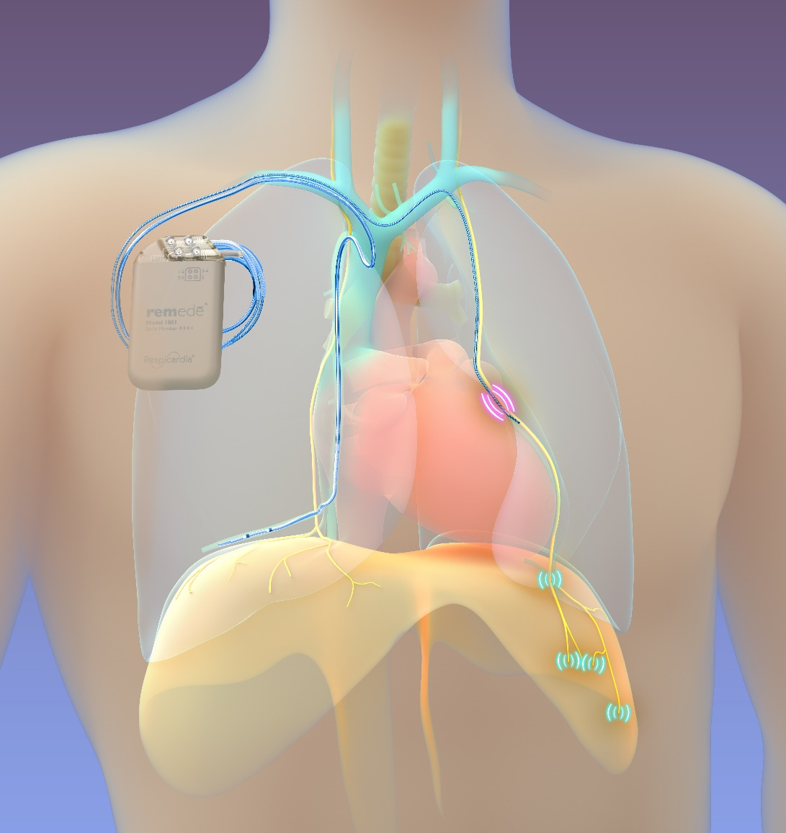
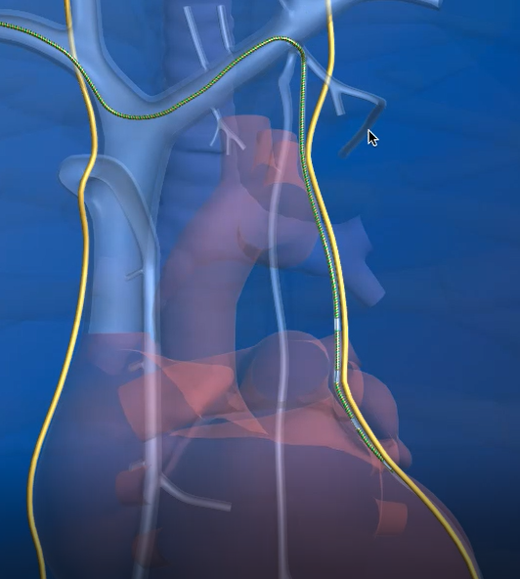
The remedē System – left stimulation lead placement
Pericardiophrenic Vein
Stimulation Lead
Phrenic Nerve
Courtesy Respicardia, Inc

Slide 45
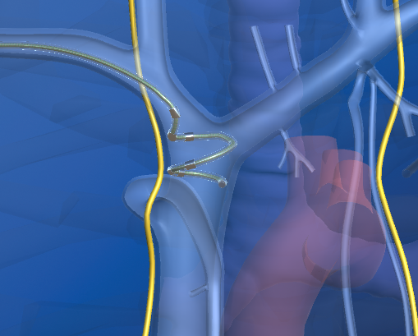
The remedē System – right stimulation lead placement
Brachiocephalic Vein
Stimulation Lead
Phrenic Nerve
Courtesy Respicardia, Inc

Slide 46
remedē® System therapy uses stimulation pulses to mimic normal breathing
Neurostimulation characteristics
Stimulation pulse setting ranges:
Amplitude: 0.1 mA – 10 mA
Pulse width: 60 µsec – 300 µsec
Frequency: 10-40 Hz
Stimulation
Pulse Amplitude
(milliAmps)
Time
Stimulation
Pulse Width
(microseconds)
Stimulation
Frequency
(Hertz)
Milliamps
Inspiration
Expiration
0.1 - 10 mA
0 mA
time
Abraham WT et al. JACC HF 2015;5:360-369

Slide 47
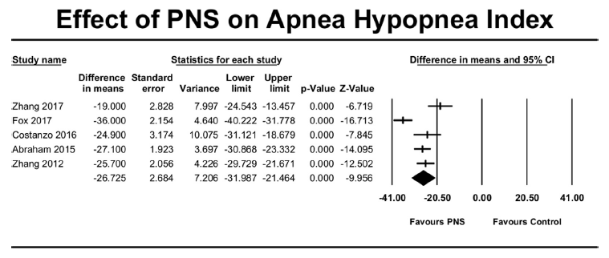
Consistent AHI reduction with phrenic nerve stimulation across multiple studies
Luni FK, et al. The American Journal of Cardiology. 2020 Jun;125(11):1738-1744. DOI: 10.1016/j.amjcard.2020.02.012.

Slide 48
The remedē® System Pivotal Trial Study design
Treatment
n=73
Therapy
On
Therapy
initiation visit
Primary effectiveness endpoint
Primary safety endpoint
Enrolled
n=151
Therapy ongoing
(follow-up every 3 months)
1 month
6 months
12 months
Control
n=78
Therapy
Off
Therapy
On
Former control group
Costanzo MR, et al. Am J Cardiol 2018;,121:1400-1408.

Slide 49
The remedē System Pivotal Trial Baseline demographics
VARIABLE | TREATMENT (N=73) |  |  | CONTROL (N=78)
Age (years) | 65 | ± | 12 | 65 | ± | 13
Male gender | 86% |  |  | 92%
Body mass index (kg/m²) | 30.8 | ± | 5.3 | 31.3 | ± | 6.6
Ejection fraction (%) | 40.6 | ± | 12.8 (n=71) | 39.4 | ± | 12.2 (n=75)
Heart failure¹ (% [NYHA I / II / III / IV]) | 66% (13 / 44 / 44 / 0%) |  |  | 62% (25 / 42 / 33 / 0%)
Atrial fibrillation | 44% |  |  | 40%
Concomitant cardiac device | 42% |  |  | 42%
Apnea hypopnea index (events/hr) | 48.8 | ± | 19.3 | 43.7 | ± | 16.8
Central apnea index (events/hr) | 30.0 | ± | 18.0 | 26.6 | ± | 16.1
Epworth sleepiness scale (points) | 10.2 | ± | 5.2 | 9.5 | ± | 5.8
¹ Required the investigator to assign a NYHA Class at the Baseline physical exam. 58% of patients had an EF <= 45%.
Mean ± SD for continuous variables/Percent for categorical variables. All nominal p-values ≥ 0.075
Costanzo MR, et al. The Lancet 2016;388:974-82

Slide 50
The majority of treated patients demonstrated a decrease in AHI at 6 months and 12 months
Improved from baseline
Improved from baseline
Worsened from baseline
88% of patients demonstrated a decrease in the number of apnea and hypopnea events per hour with the remedē System at 6 months^{1,2}
91% of patients demonstrated a decrease in the number of apnea and hypopnea events per hour with the remedē System at 12 months³
1. Costanzo MR, et al. Lancet. 2016; 388: 974–82.
2. 48% of the control group had a decrease in AHI.
3. Costanzo M, et al. Am J Cardiol 2018;121:1400-1408

Slide 51
Post hoc analysis of the heart failure cohort demonstrated similar benefit in sleep and quality of life
Post-hoc analysis showed improvements from baseline at 12 months¹
Sleep metrics (All p= or < 0.001)
Apnea Hypopnea Index (AHI)
Central Apnea Index (CAI)
Oxygen Desaturation Index (ODI)
Arousal Index
% of sleep in REM
ODI4 (events/hour)
% of sleep with O2 saturation < 90%
Epworth Sleepiness Scale
3.1 ± 4.7 point improvement from baseline (p<0.001)
Minnesota Living with Heart Failure
6.8 ± 20.0 point improvement from baseline (p=0.005)
Similar results in quality of life improvements in heart failure cohort as broader patient population²
Patient Global Assessment
Marked or moderate improvement
No change
Mild improvement
Worsened
Improved
No change/worse
Per protocol with heart failure
1 Constanzo et al., Eur J Heart Fail 2018; 1746-1754.
2 Goldberg et al., J Cardiac Fail 2017;23:S15

Slide 52
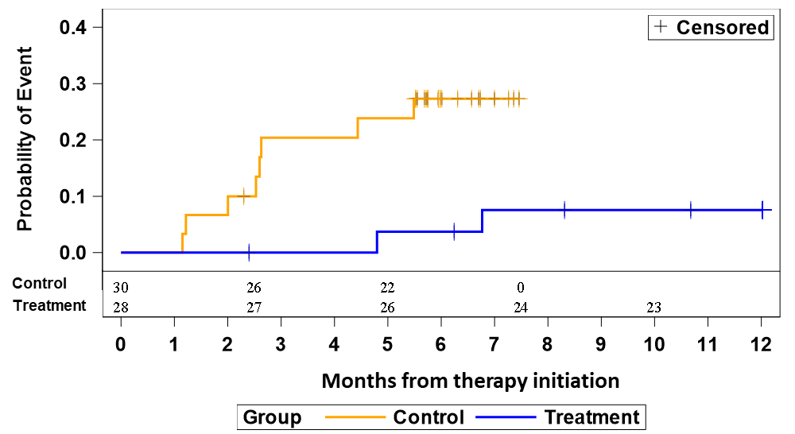
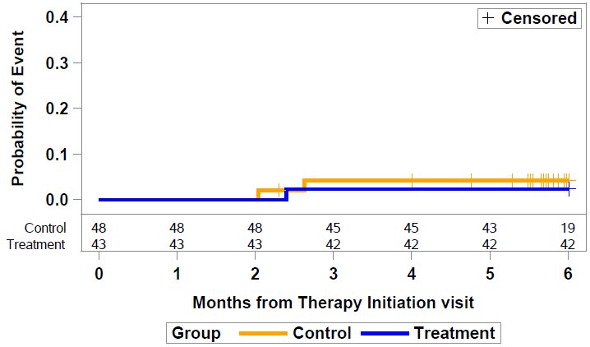
Published post hoc analysis explored changes in LVEF, time to first HF hospitalization and time cardiovascular death in the heart failure cohort
Change in LVEF for treatment patients at 12-mo
(Subgroup with HF, EF≤45% and no permanent AF)¹
Kaplan-Meier Curve of Months to First
HF Hospitalization
(Subgroup with NYHA II-III and EF≤45%)²
Kaplan-Meier Curve of Months to
Cardiovascular Death
(Subgroup with HF)¹
Nominal two-sided P-value p=0.004*
12 Month rate
Treatment: 7.6%
Log-rank p-value=0.014
Log-rank p-value=0.617
Mean Left Ventricle Ejection Fraction %
30 23 9 0 0
28 27 26 23 22
6 Month HF hospitalization rate:
Treatment: 3.7%
Control: 27.3%
12 Month HF hospitalization rate:
Treatment: 7.6%
Baseline
12-months
N=50
N=41
Control subjects censored when therapy turned on at 6 months
Control subjects censored when therapy turned on at 6 months
*Nominal two-sided P-value from Wilcoxon signed-rank test for change from baseline.
Note: The all-cause death Kaplan-Meier curve is identical to this curve since all deaths in first 6 months were CV related.
*remedē is not indicated to treat, cure, prevent, mitigate or diagnose heart failure. These data represent unspecified secondary endpoints.
Costanzo et al. Eur J Heart Fail 2018; https://doi.org/10.1002/ejhf.1312
Ponikowski P, et al. Eur J Heart Fail 2019;21 (S1): 346; doi:10.1002/ejhf.1488

Slide 53
Therapy response was consistent across subgroups
Forest plot showing the proportion of subjects achieving at least 50% reduction in AHI for subgroups of interest¹
24 Months of Therapy Subgroup | AHI Reduced ≥ 50% Treatment Group % (n/N)
Age
<65 | 54% (13/24)
≥ 65 | 67% (12/18)
Sex
Female | 80% (4/5)
Male | 67% (21/37)
Heart Failure
No | 62% (13/21)
Yes | 57% (12/21)
Height (Median)
<176 cm | 65% (13/20)
≥176 cm | 55% (12/22)
Hypopnea Index (Median)
<14 Events/Hour | 43% (9/21)
≥14 Events/Hour | 76% (16/21)
Defibrillator
No | 55% (17/31)
Yes | 73% (8/11)
BMI (Median)
<30.5 | 71% (15/21)
≥30.5 | 48% (10/21)
Prior SDB Therapy
No | 64% (14/22)
Yes | 55% (11/20)
Atrial Fibrillation
No | 57% (17/30)
Yes | 67% (8/12)
Proportion With AHI Reduced ≥ 50%
(95% CI)
1 Fox H, et al, SLEEP, zsz158, https://doi.org/10.1093/sleep/zsz158
0
25
50
75
100

Slide 54
remedē System Pivotal Trial Safety Events
Primary Safety Endpoint:
Serious Adverse Events Related to Implant, Procedure, remedē System, and/or Delivered Therapy through 12 Months
Intention to Treat
(N=151)
Any serious related AE | 13 | 9%
Lead Dislodgment¹ | 2 | 1%
Impending Pocket Erosion | 2 | 1%
Implant Site Infection | 2 | 1%
Concomitant Device Interaction | 1 | 1%
Extra Respiratory Stimulation² | 1 | 1%
Lead Component Failure | 1 | 1%
Lead Displacement³ | 1 | 1%
Implant Site Hematoma | 1 | 1%
Non-Cardiac Chest Pain | 1 | 1%
Elevated Transaminase | 1 | 1%
n (Events)
% (Patients)
Costanzo MR, et al. The Lancet 2016;388:974-82

Slide 55
remedē System Therapy Study (rēST Study) Design
Multi-center, prospective, non-randomized study
Safety and effectiveness data in subjects implanted with the remedē
System
Approximately 500 subjects and 50 sites in the United States and the
Europe
Participation is expected to continue through five years
Enhanced assessments in HF subjects

Slide 56
reST Study Key Objectives
Changes in sleep metrics
At 12, 36 and 60 months
Evaluate changes in daytime sleepiness from baseline using the Epworth Sleepiness Scale (ESS)
Evaluate impact on quality of life (QOL) using the
PROMIS-29 questionnaire, and
Patient Global Assessment (PGA)
HF patients will undergo additional assessments
Changes in LVEF at 12 months
BNP
Disease specific QOL (KCCQ)
Exercise tolerance
HF hospitalizations

