Slide 1
remedē® System
Peer-to-Peer Slides
MAF1937 rev F

Slide 2
Central Sleep Apnea Overview and Pathophysiology
MAF1937 rev F

Slide 3
Agenda
Central sleep apnea definition
Consequences of CSA
Current treatment options
MAF1937 rev F

Slide 4
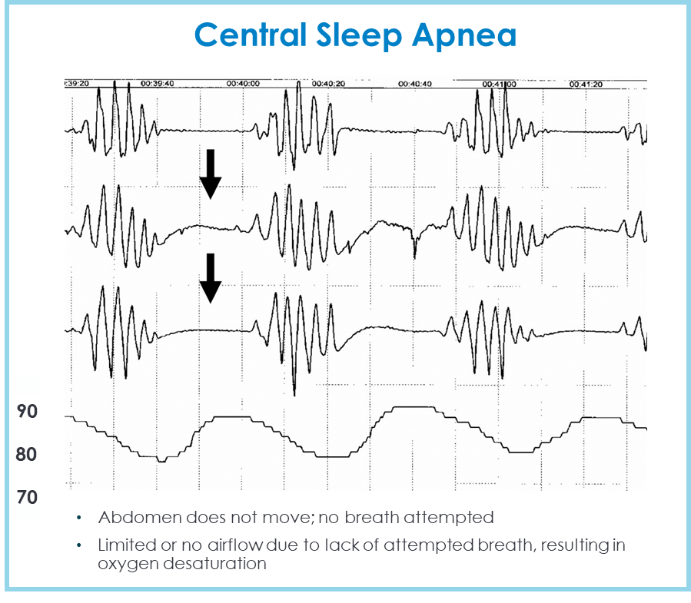
Pathophysiology of Central Sleep Apnea
During sleep, respiration is regulated by the brain whose goal is to maintain a constant blood CO₂
In patients with central sleep apnea, the brain develops a respiratory arrhythmia that manifests as an oscillating pattern between hyperventilation and apnea/hypopnea (Cheyne-Stokes Respiration (CSR))
Chest belt
Abdominal belt
Airflow
Dempsey et al. Physiol Rev 2010; 90:47-112
Orr et al. Respirology 2017; 22, 43–52. Pham, et al High Alt Med Biol 2017; 18: 11-19
MAF1937 rev F
Notes:
During sleep, respiration is regulated by the respiratory control center in the brain to maintain a constant carbon dioxide level in the blood. When carbon dioxide levels rise, signals are sent to the muscles of respiration to breathe. The largest breathing muscle is the diaphragm which receives its signal via the phrenic nerve. In CSA, there is a delay in the signaling process which produces a respiratory arrhythmia leading to an oscillation between hyperventilation and apnea.
One form of this patterned breathing, Cheyne-Stokes Respiration, can be seen during the daytime in patients with heart failure. However, patients with very mild heart failure and without heart failure can be found to have this pattern at night.
Shown on the left is this pattern of breathing characterized by a lack of movement on the chest and abdominal belts with no airflow during events followed by rapid, deep breathing

Slide 5
The Cycle of High Loop Gain CSA/CSR
Hyperventilation
Decreased CO2 levels
Delay in RCC identification of the drop in CO2
Hypoventilation or Apnea
CO2 levels rebound above apnea threshold
Delay in RCC identification of CO2 change
Causes of delay by respiratory control center (RCC -increased loop gain)
Elevated sympathetic activation
Low ejection fraction
Medications
Dempsey et al. Physiol Rev 2010; 90:47-112
Orr et al. Respirology 2017; 22, 43–52
MAF1937 rev F
Notes:
CSA typically begins with a hyperventilatory episode which drops CO2 below the apnea threshold. In patients with CSA, there is a delay in the respiratory control center of the brain to identify and react to this drop which results in an apneic or hypoventilatory event which brings CO2 levels back up. However, there is again a significant delay which causes a high CO2 level and then a reactive hyperventilatory episode.
This delayed signal can be driven by increased sympathetic activation leading to decreased chemosensitivity, low cardiac output, high altitude or medications. Patients with more than one of these increase the risk of CSA development

Slide 6
CSA can result from multiple disorders
High loop gain
Cardiovascular disorders (Heart failure and atrial fibrillation)
High altitude
Idiopathic
Treatment-emergent CSA (TECSA; Complex CSA)
Other medical illnesses (acromegaly, renal failure)
Medications
Brainstem and spinal cord disorders
Neuromuscular disorders
Failure to generate rhythm
Medications
Neurodegenerative
Brainstem
Head injury
Javaheri S and Badr S. SLEEP 202346(3):zsac113. doi: 10.1093/sleep/zsac113.
MAF1937 rev F
Notes:
CSA is associated with multiple co-morbidities and disorders, but there are two basic mechanisms. High loop gain as previously discussed or a failure of the brain to generate adequate breathing due medications or damage to the brain or nerves. Patients with these disorders should be considered high risk for CSA

Slide 7
CSA is Not Limited to Heart Failure
 | VA (N=2,961) | French Cohort (N=480) | Sleep Heart Health (N=55)
Age (years) | 61.8 ± 15.6 | 65 [55, 73] | 69 ± 10
Male | 95.7% | 86.7% | 91%
White race | 78.5% | - | 93%
BMI (kg/m²) | Median <30 | 27.3 [24.4, 30.6] | 28.0 +/- 4.6
Hypertension | - | 48.5%
Diabetes | >29%? | 22.7% | 13%
MI | 4.7% | - | 15%
AF | - | 22.3% (arrhythmias) | 18%
Stroke | - | 17.9% | 7%
HF | 15.9% | 26.5% | 7%
Methadone | - | 5.6% (opioids) | 5.5%
Agrawal et al. Annals Am Thor Soc 2023;20:450-55.; Pepin JL et al. Sleep Med 2024;124:426-433; Nieto et al. JAMA 2000; 283(14):1829-1836
MAF1937 rev F
Notes:
While CSA is often linked to heart failure, as demonstrated by several studies, CSA patients have multiple other co-morbidities such as AF, stroke and diabetes.

Slide 8
Etiology of CSA
Currently in the sleep lab the 3 highest etiologies are
Primary CSA
HF
AF
CSA is found in approximately 35% of HFrEF patients and 20% of AF and HF patients
Pepin JL et al. Sleep Med 2024;124:426-433
MAF1937 rev F

Slide 9
Risk Factors for CSA
Male gender
Atrial fibrillation
Age > 60
Ejection fraction < 30%
Cerebrovascular accident
Spinal cord injury
Badr 2019 Curr Pulmonol Rep. 8(1): 14-21. doi:10.1007/s13665-01
MAF1937 rev F
Notes:
CSA has different risk factors from OSA. Notably absent is high BMI. CSA is less common in females even after menopause. It is still unclear why the difference is so significant especially in CSA associated with heart failure.

Slide 10
Definitions of CSA
This is not uniform in the clinical literature
ICSD predominant central sleep apnea
CAI > OAI or
CAHI > OAHI
Moderate to severe CSA (used in TPNS studies)
CAHI > 15 events per hour or
AHI > 15 and CAI > OAI
What if hypopneas are not classified?
MAF1937 rev F
Notes:
On difficulty in comparing CSA studies is the lack of a uniform definition. The international classification of sleep disorders defines predominant CSA as more central events than obstructive which can be define using only apneas or apnea and hypopnea events.
In some studies, a central apnea hypopnea index above 15 was sufficient for a moderate CSA diagnosis.

Slide 11
CSA Identification Improves with Hypopnea Classification
CSA diagnosis was 4x higher using central hypopneas:
Only 4.59% of patients were defined as CSA when ignoring hypopnea class, compared to 19.69% when accounting for hypopnea classification.
Pepin JL, et al. Sleep Medicine 2024;124:426-433
MAF1937 rev F
Notes:
Hypopnea classification is of growing importance. Shown in this study from France, only 4.5% of patients were predominantly central when using apneas only, but almost 20% of patients were predominantly central if hypopneas were distinguished between central and obstructive. In addition, another 19% of patients had significant amounts of CSA.

Slide 12
Identification of CSA by Sleep Study
In-laboratory PSG remains the gold standard
Hypopneas are important
If any central apneas – look closely at the hypopneas
Home studies
Flow-based HSAT
Typically, not certified for central events, but may be only study for a patient
Document any central events
May predict CPAP/BPAP failures
Prevents inappropriate therapies for CSA
PAT-based HSAT
Often can identify patients with some central events
Still recommend PSG for confirmation
MAF1937 rev F
Notes:
An in-laboratory PSG remains the gold standard for the diagnosis of CSA. It is important to note that in patients at risk for CSA, hypopneas should not be automatically called obstructive as this can lead to an incorrect diagnosis.
Many patients today are testing utilizing home testing equipment, even those at risk for CSA. These automated reports often call all sleep apnea or all hypopneas obstructive. If any central apnea events are noted, these studies deserve a second look to confirm there is not significant CSA during the test. This could lead to a diagnosis of “treatment-emergent CSA” when there was a failure to recognize this on the baseline test.
PAT based HSAT such as WatchPAT are identifying CSR breathing pattern which can occur in patients with OSA and may miss some patients with periodic breathing (short cycle CSA). If there is evidence of CSA, this should be confirmed by PSG before moving towards implantable therapies.

Slide 13
Each Central Sleep Apnea Episode Results in Significant Downstream Effects
Central Sleep Apnea
Hypoxia
Ischemia
Inflammation
Arousal
Disturbed
sleep
Sympathetic Activation
Dementia
Myocardial infarction
Stroke
Cancer
Endothelial dysfunction
↓Mental acuity
Fatigue
↑Renin
↑ Heart rate
↑ Peripheral vascular resistance
Courtesy S Javaheri, with permission
MAF1937 rev F
Notes:
Each CSA should be thought of as a discrete event leading to an arousal and hypoxia. The downstream and chronic effects of these evets effect almost every organ resulting in patient reported symptoms of fatigue and decreased mental acuity as well as sympathetic activation, ischemia and inflammation

Slide 14
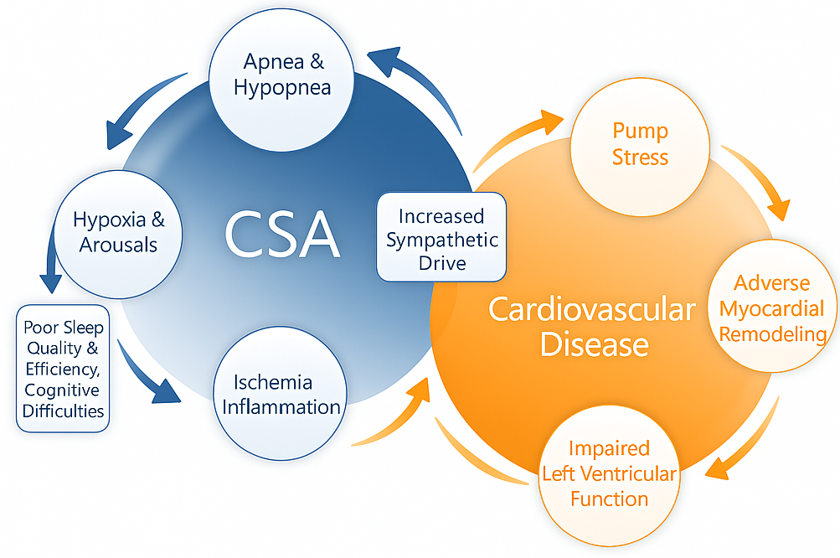
CSA has a unique relationship with cardiovascular patients and can accelerate cardiac disease progression
Reciprocal Interaction between CSA and Cardiovascular Disease
Adapted from Bekfani and Abraham, Europace 2016; 18:1123-24
MAF1937 rev F
MKT1674, Rev P
Notes:
This is even more pronounced in the cardiac patient. CSA has a unique relationship with heart failure as it may be the trigger for CSA. Conversely, untreated CSA leads to pump stress and the eventual development of heart failure or atrial fibrillation. Importantly, each episode of CSA causes a discrete surge of nor-epinephrine triggering arrhythmias and chronically, cardiac muscle fibrosis.

Slide 15
CSA Increases Cardiovascular Risk
Central sleep apnea increases the risk for:
Heart Failure (Sleep Heart Health Study)
Atrial Fibrillation (MrOs Study)
Cerebrovascular accident
Javaheri S. SLEEP, 2025, 48, 1–20
https://doi.org/10.1093/sleep/zsae307
MAF1937 rev F
Notes:
Multiple studies have now demonstrated the development of cardiovascular disease in patients with idiopathic CSA. There is twice the risk of heart failure and atrial fibrillation as well as an increased risk of stroke

Slide 16
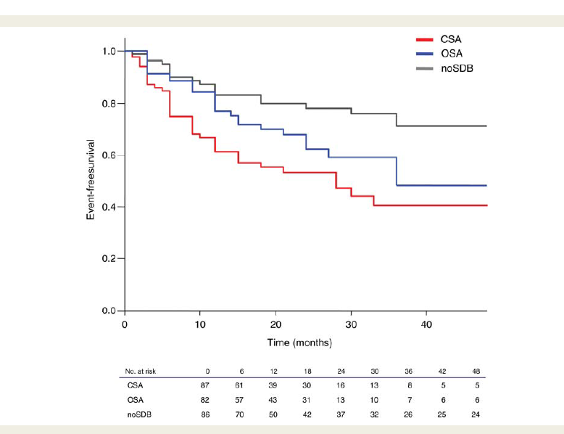
Central Sleep Apnea Predicts Appropriate ICD Therapies
Kaplan–Meier plot on appropriate cardioverter-defibrillator therapies
CSA is typically a worse prognosis than OSA
Bitter et al. Eur Heart J 2011;32:61-74.
MAF1937 rev F
Notes:
In patients with low EF, the effect is more pronounced with a high rate of appropriate ICD shocks and an average time to first appropriate ICD shock of 14 months.

Slide 17

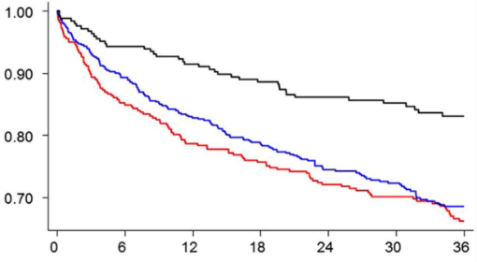
The addition of sleep apnea to heart failure significantly increases mortality and hospitalizations
Survival – Heart failure (LVEF< 45%) with CSA patients vs. heart failure with normal breathing in NIH sponsored study
Untreated sleep apnea in HF patents is associated with a 2-fold increase in risk of death
Patient Survival
Hazard Ratios
CSA vs. no or minimal SDB | OSA vs. no or minimal SDB
2.17 p < 0.001 | 2.00 p < 0.001
Number at risk
Months Post Discharge
CSA
OSA
nm SDB
338
513
245
288
458
231
266
425
224
256
404
217
230
343
195
203
283
173
161
228
143
Kayat, R et al. Sleep disordered breathing and post-discharge mortality in patients with acute heart failure, European Heart Journal 2015;36 1463–1469.
MAF1937 rev F
Notes:
Increased mortality in patients with heart failure has been demonstrated in multiple studies. Shown here is an NIH study out of the Ohio State University demonstrating the risk of sleep apnea on mortality. CSA was the number one predictor of mortality in the cohort.

Slide 18
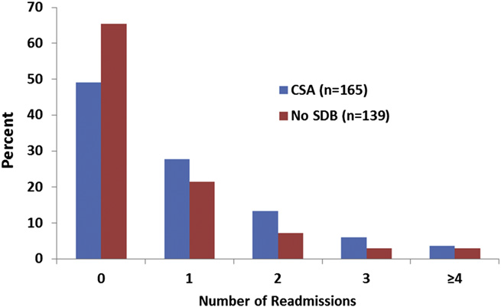
Central Sleep Apnea Increases the Risk of Heart Failure Readmission
Heart failure readmissions within 6 months – CSA population vs. patients free of sleep disordered breathing (SDB) in NIH sponsored study
Percent of patients
Central Sleep Apnea (n=165)
No Sleep Disordered Breathing (n=139)
>50% of CSA Patients
Hazard ratios
CSA vs. no SDB
1.63, p = 0.01
>25% of CSA Patients
50% of HF patients with CSA were readmitted to the hospital at 6 months
Over 25% of heart failure patients with CSA had 2 or more hospital readmissions within 6 months
Khayat et al. J Card Fail 2012;18:534-540
MAF1937 rev F
Notes:
Central sleep apnea also increases the risk for heart failure re-hospitalization. The same study demonstrated that half of patients with CSA returned to the hospital in 6 months and 1 in 4 had multiple hospitalizations.

Slide 19
CSA has very few treatment options compared to OSA
CSA Treatment Options
OSA Treatment Options
PAP
Some modes & models are appropriate (CPAP, BPAP, ASV
PAP
Many modes, models, and fits
TPNS
Transvenous Phrenic Nerve Stimulation (remedē)
Behavioral
Weight loss, avoidance of alcohol and sedatives, positional
Other
Pharmacologic, oxygen
Oral appliances
Mandibular repositioning appliances, tongue retaining devices, etc.
Surgical
Nasal, Oral, Oropharyngeal, Nasopharyngeal, Hypopharyngeal, Laryngeal, Global Airway
Adjunctive
Bariatric Surgery, Pharmacologic, Oxygen
Other
Hypoglossal Nerve Stimulation
https://aasm.org/resources/clinicalguidelines/osa_adults.pdf
MAF1937 rev F
Notes:
As opposed to OSA, CSA has few treatment options which include positive airway pressure therapies, medications, oxygen and transvenous phrenic nerve stimulation.

Slide 20

Transvenous phrenic nerve stimulation recommended as a treatment option in the 2025 AASM CSA guidelines
MAF1937 rev F
Notes:
This year transvenous phrenic nerve stimulation was added to the CSA guidelines.

Slide 21

AASM updated recommendations for adults with Central Sleep Apnea
Critical Outcomes Meeting Clinical Significance Threshold²
Intervention
Strength of Recommendation
Excessive Sleepiness
Disease Severity
Cardiovascular Disease
NEW
to the guidelines
Transvenous PNS³
Conditional for
CPAP⁴
Conditional for
BPAP w/ backup rate⁵
Conditional for
BPAP w/o backup rate⁴
Conditional against
ASV⁴
Conditional for
Low-flow oxygen⁶
Conditional for
Acetazolamide⁴
Conditional for
1 Does not include central sleep apnea due to high altitude
2 Excluded hospitalizations, sleep quality, and mortality, for which no intervention met the Clinical Significance Threshold or could not be assessed
3 Primary CSA and CSA due to heart failure
4 Primary CSA, CSA due to HF, CSA due to medication or substance use, treatment-emergent CSA , and CSA due to a medical condition or disorder
5 Primary CSA, CSA due to medication or substance use, treatment-emergent CSA, and CSA due to a medical condition or disorder
6 CSA due to heart failure
Badr MS et al. Treatment of central sleep apnea in adults: an American Academy of Sleep Medicine clinical practice guideline. J Clin Sleep Med 2025 in press
MAF1937 rev F
Notes:
Shown here are the recommendations for treatment of CSA in heart failure patients and in patients with primary CSA.
TPNS, CPAP, BiPAP with a backup rate, ASV, oxygen, and acetazolamide are all options for these patients.
BiPAP without a backup rate is NOT recommended due to the potential to worsen CSA.
Only TPNS and BiPAP have met the outcomes measures of daytime sleepiness, disease severity and CVD

Slide 22
Recent Clinical Data on Non-neurostimulation Therapies
MAF1937 rev F
Notes:
While this presentation, does not have time to cover all CSA studies, three recent studies deserve mention.

Slide 23
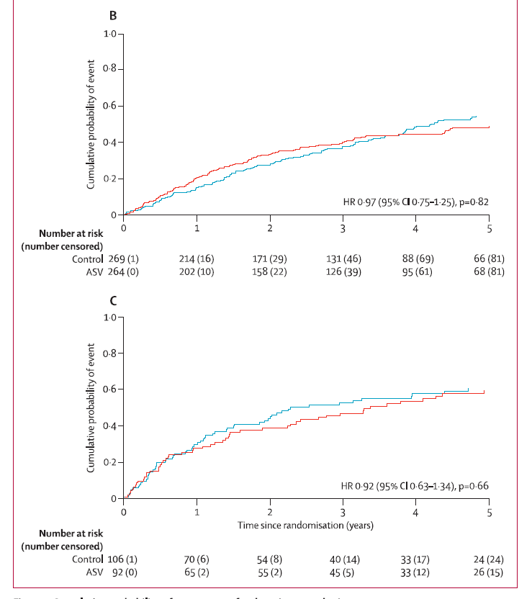
ADVENT-HF
OSA Patients (non-sleepy)
New information for 2025 AASM and ERS Guidelines
Overall neutral trial
No significant harm
Utilized different ASV algorithm from SERVE-HF
CSA Patients
Bradley, T Douglas et al.
The Lancet Respiratory Medicine, Volume 12, Issue 2, 153 - 166
MAF1937 rev F
Notes:
ADVENT-HF was a study which started over 10 years ago which enrolled HFrEF patients without daytime sleepiness and OSA or CSA. The study had some difficulty due to the SERVE-HF study, COVID and a recall on the ASV device use. The study was overall neutral, but importantly, did not show harm in the CSA population. Improvements were seen in AHI, arousals, and sleep quality.

Slide 24
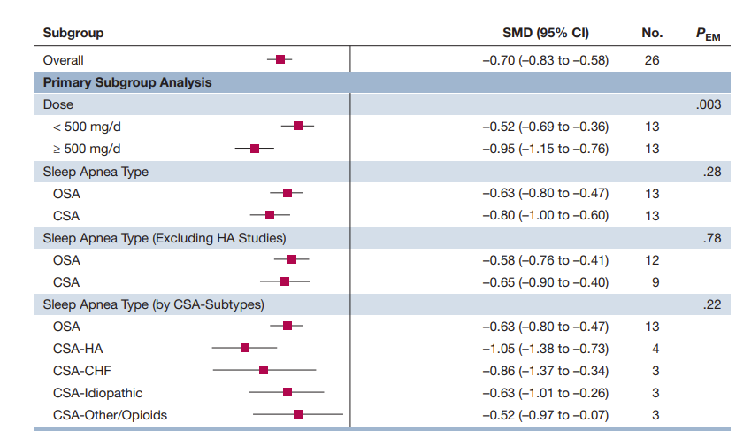

Changes in AHI with Acetazolamide Meta-analysis
Improvements in AHI with acetazolamide
Some benefits in both OSA and CSA
Schmickl et al. 2020 CHEST 158:2632-45
MAF1937 rev F
Notes:
In a meta-analysis, Schmickl et al looked at studies in both OSA and CSA using acetazolamide. Acetazolamide was able to improve AHI across multiple subtypes

Slide 25
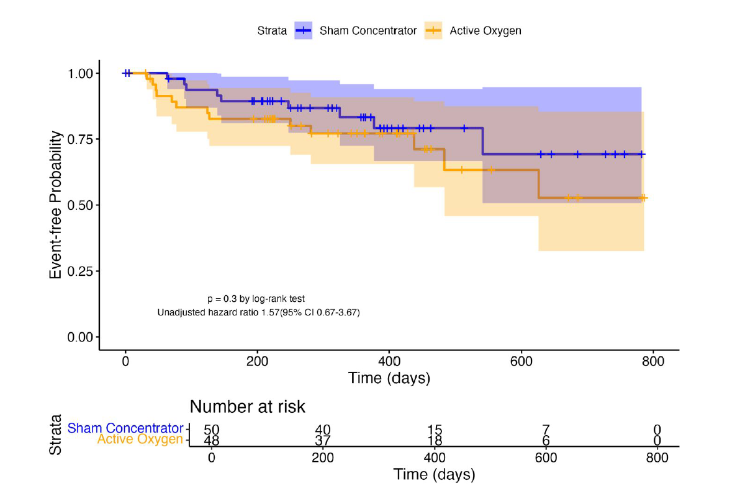
Low flow oxygen for CSA (LOFT-HF)
Study stopped early and underpowered
No significant differences between the groups for quality of life
Treatment group with NS increase in mortality
Data released after AASM Guidelines
Redline et al. Annals ATS 2025 in press
MAF1937 rev F
Notes:
Low flow oxygen was used in the LOFT-HF study. This study was stopped very early due to a lack of funding after COVID and poor enrollment. However, as shown here, patients on oxygen did not seem to see a benefit even in this small CSA population.

Slide 26
Conclusions
Central sleep apnea is caused from a failure of appropriate signaling of the respiratory muscles
CSA is associated with a number of co-morbidities and increases the risk for poor outcomes
Without evaluating hypopneas, significant CSA may be missed
There are few treatment options for CSA patients, but the new 2025 AASM CSA guidelines recommends TPNS (offered by remedē)
MAF1937 rev F

Slide 27
remedē® System Device Function and Diagnostics
MAF1937 rev F

Slide 28
Agenda
The remedē System
Components and implantation
Device function
Diagnostics overview
MAF1937 rev F

Slide 29
The remedē® System brief statement
Indications for Use
The remedē® System is indicated for moderate to severe Central Sleep Apnea (CSA) in adult patients. A doctor will need to evaluate the patient’s condition to determine if the remedē System is appropriate.
The remedē® System should not be implanted during an active infection and patients will not be able to have diathermy (special heat therapies). The device is MR Conditional. The conditions and precautions can be found in the remedē system MRI guidelines manual. The remedē System may be used with another stimulation device such as a heart pacemaker or defibrillator; special testing will be needed to ensure the devices are not interacting.
As with any surgically implanted device, there are risks related to the surgical procedure itself which may include, but are not limited to, pain, swelling, and infection. Once the therapy is turned on, some patients may experience discomfort from stimulation and/or from the presence of the device. The majority of these events are resolved either on their own or by adjusting the therapy settings.
The remedē System may not work for everyone. There are additional risks associated with removing the system. If it is decided to remove the system, another surgery will be required. Be sure to understand all the risks and benefits associated with the implantation of the remedē System. For further information please visit remede.zoll.com, call 952-540-4470 or email info@remede.zoll.com.
Contraindications: The remedē System is contraindicated for use in patients with an active infection. See the Instructions for Use for complete information regarding the procedure, indications for use, contraindications, warnings, precautions, and potential adverse events.
MAF1937 rev F
MKT1674, Rev P

Slide 30
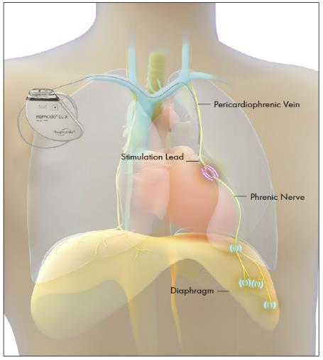
Transvenous phrenic nerve stimulation with the remedē® system
Fully implantable system with an indication to treat moderate to severe central sleep apnea in adults
Stabilizes breathing by activating the diaphragm to generate negative pressure in the chest (similar to natural breathing)
Turns on automatically at night, ensuring nightly compliance and adherence over time
Implanted by cardiac electrophysiologists (EPs)
Pulse generator implanted below clavicle
Stimulation lead placed either in left pericardiophrenic or right brachiocephalic vein
Diaphragm
FDA-Approved Summary of Safety and Effectiveness Data (SSED) for the remedē® System and The remedē System Implant and Clinician Use Manual (P160039) Oct. 6, 2017.
MAF1937 rev F
MKT1674, Rev P
Notes:
The remede System is a fully implantable system with a transvenous stimulation lead indicated to treat moderate to severe central sleep apnea in adults
It is designed to stabilize breathing by stimulating the phrenic nerve to contract the diaphragm and generate negative pressure similar to normal breathing
A unique feature of the remede System is its ability to activate automatically at night which ensures compliance over time.
The implant is performed by a cardiac electrophysiologist similar to cardiac device placements with the stimulation lead placed near the phrenic nerve in either the left pericardiophrenic or right brachiocephalic vein

Slide 31
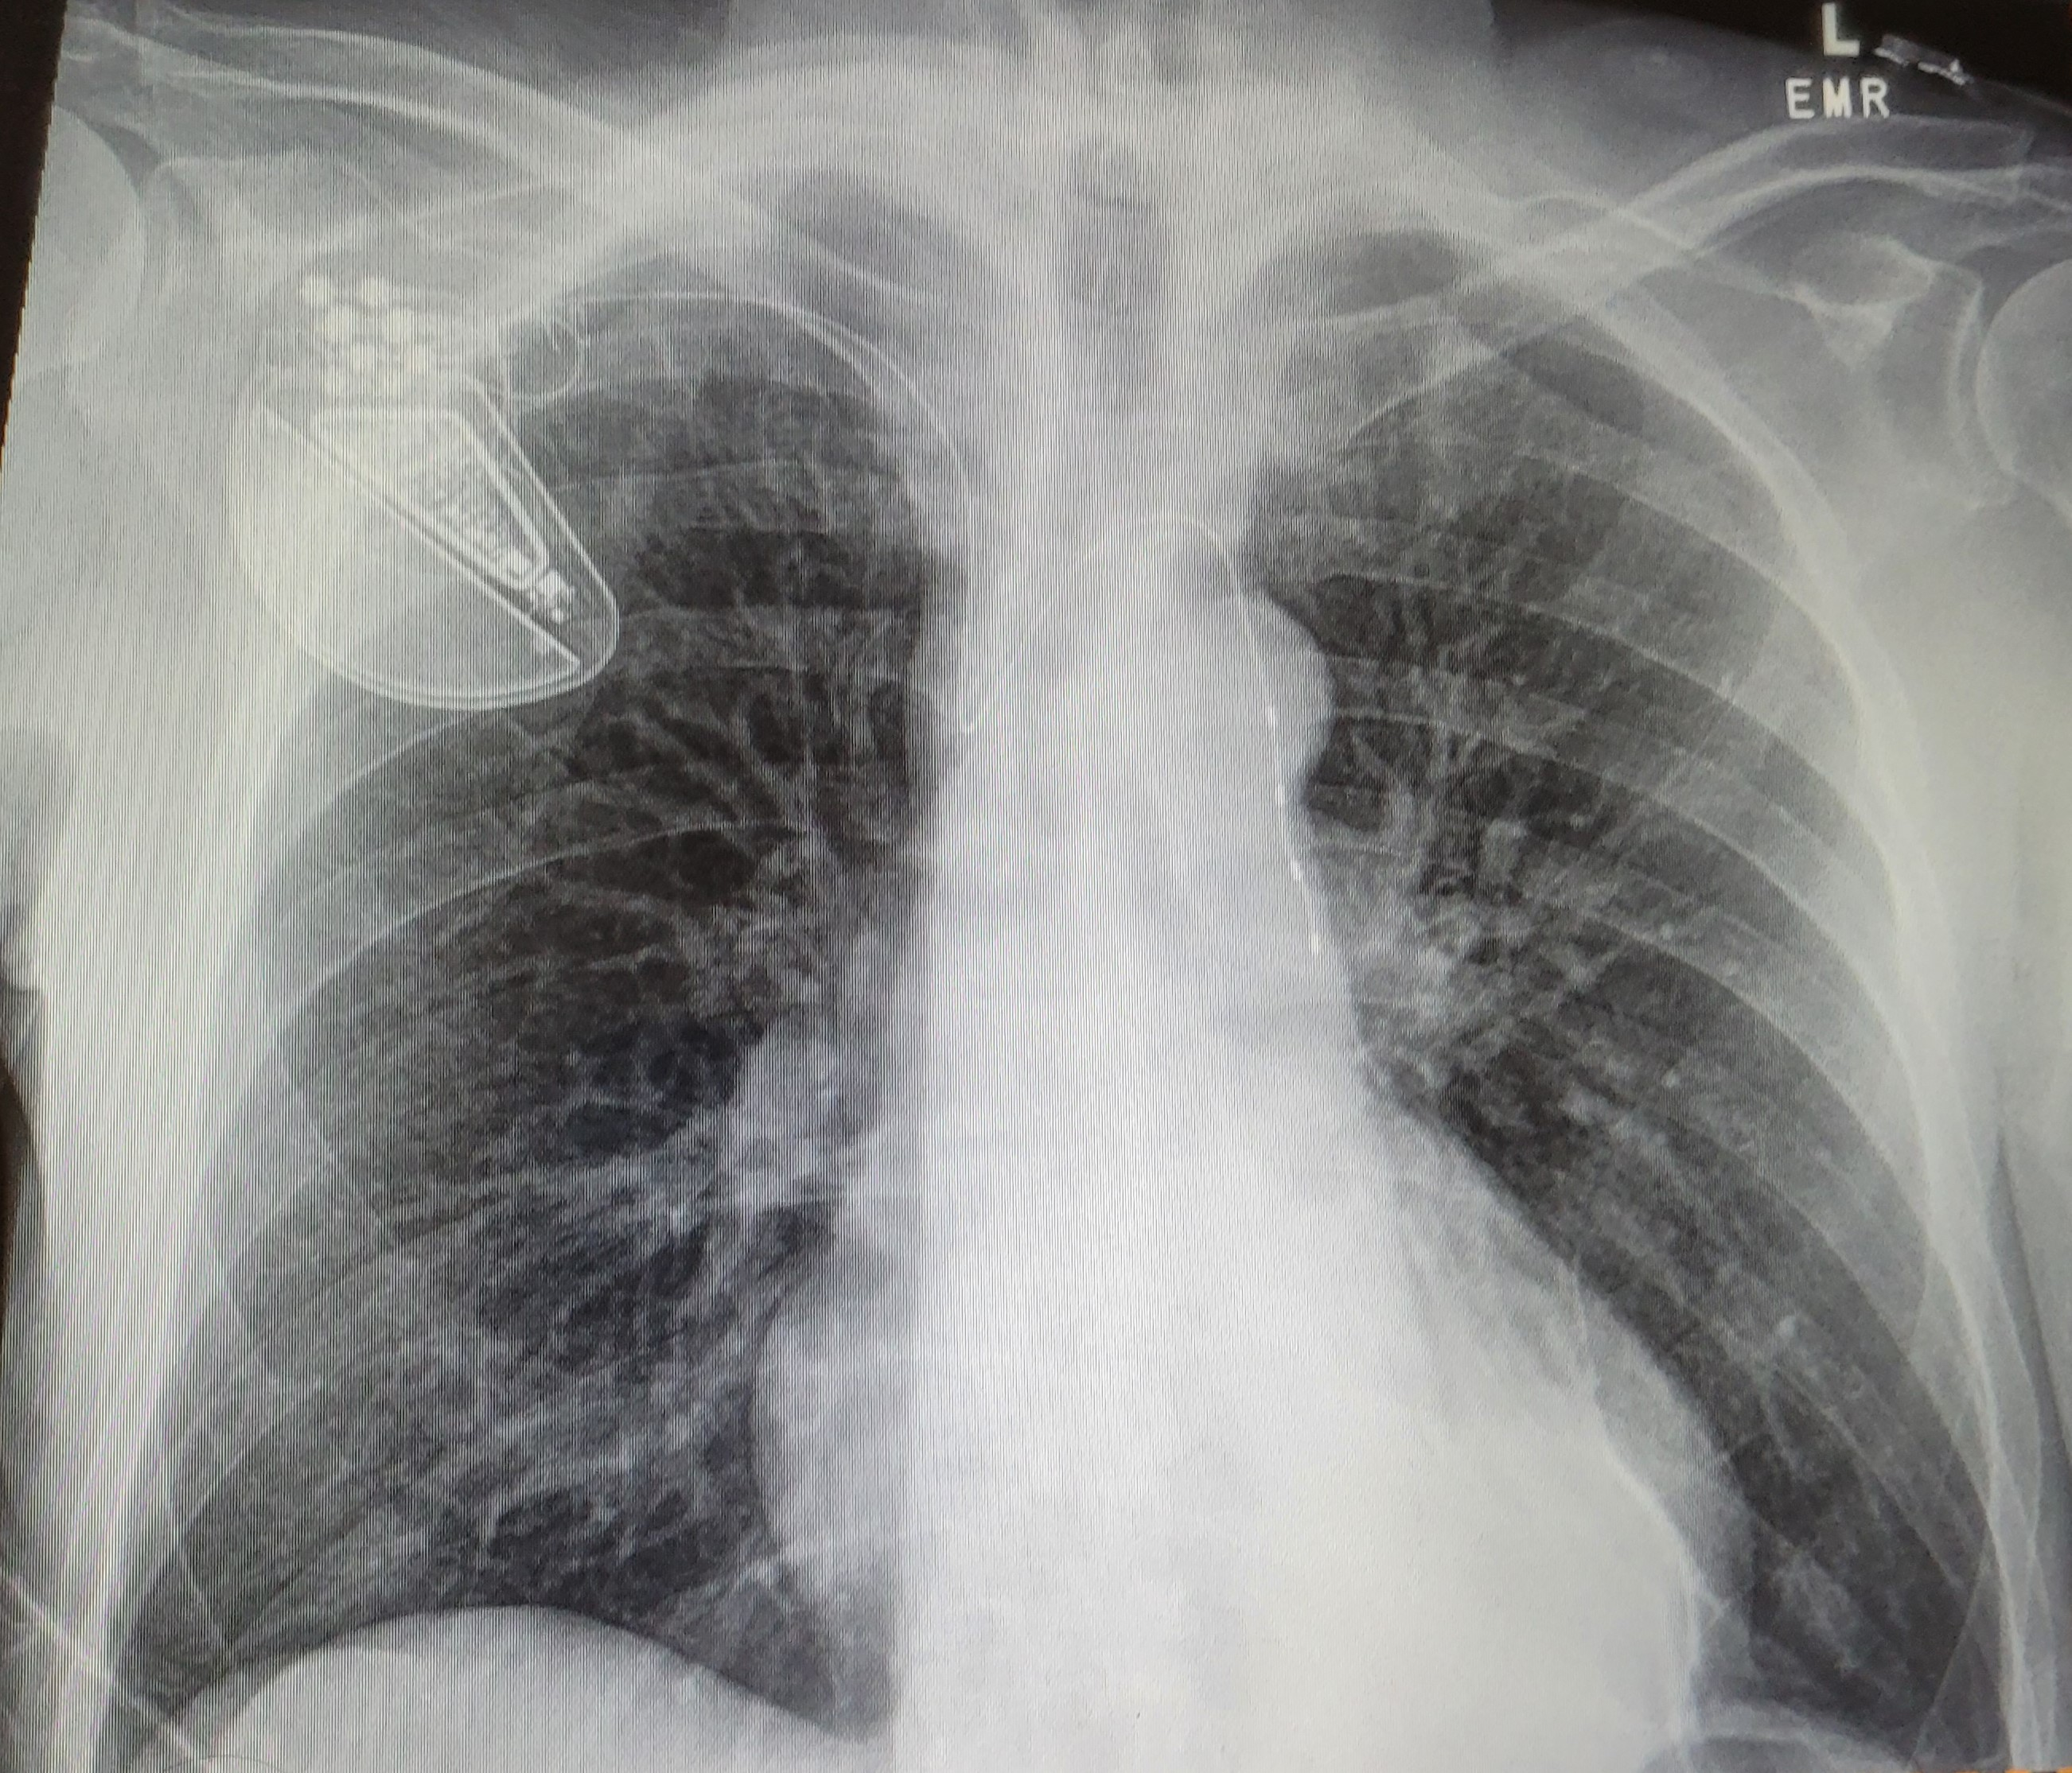
The remedē® System implanted
remedē EL System
Respistim® Stimulation Lead in the left pericardiophrenic vein
MAF1937 rev F
MKT1674, Rev P
Notes:
Shown here is an x-ray of the device with the lead in the left pericardiophrenic vein. Stimulation typically occurs in a bipolar stimulation between 2 electrodes (4 shown here).

Slide 32

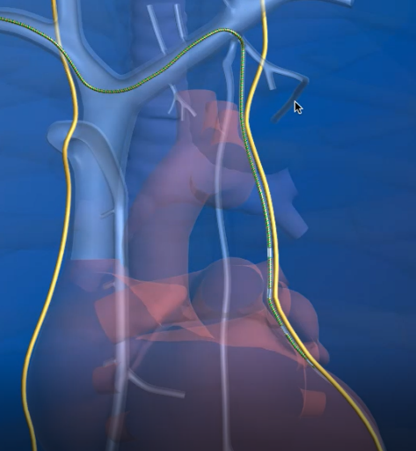
The remedē® System: left stimulation lead placement
Pericardiophrenic Vein
Stimulation Lead
Phrenic Nerve
MAF1937 rev F
MKT1674, Rev P

Slide 33
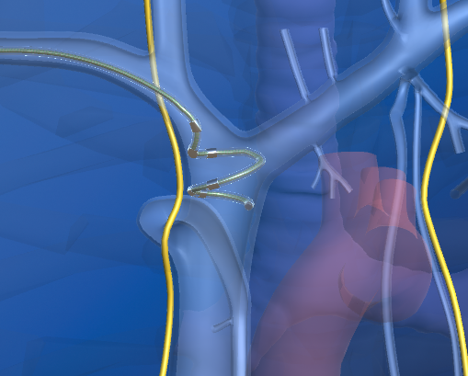

The remedē® System: right stimulation lead placement
Stimulation Lead
Brachiocephalic Vein
Phrenic Nerve
MAF1937 rev F
MKT1674, Rev P

Slide 34
remedē® System therapy activates automatically each night
Therapy is Delivered When…
It is within the pre-programmed sleeping hours…
…AND the patient is reclined past the programmed sleeping angle…
…AND the patient is not moving
Example
11:00 pm
Therapy is Paused When…
the patient rolls
…OR the patient sits up
Therapy resumes ~1 minute after a roll or ~10 minutes after the patient returns to the sleeping position after getting up
MAF1937 rev F
MKT1674, Rev P
Notes:
The remede System activates automatically when the following criteria are met: time, position (pitch), activity and lead impedance (safety check)
Stimulation can be suspended by rolling to a different quadrant or sitting up. All of these are programmable settings.

Slide 35
remedē® System therapy uses stimulation pulses to mimic normal breathing
Neurostimulation characteristics
Stimulation
Pulse Amplitude
(milliAmps)
Stimulation pulse setting ranges:
Amplitude: 0.1 mA – 10 mA
Pulse width: 60 µsec – 300 µsec
Frequency: 10-40 Hz
Time
Stimulation
Pulse Width
(microseconds)
Stimulation
Frequency
(Hertz)
Milliamps
Inspiration
Expiration
0.1 - 10 mA
0 mA
time
Abraham WT et al. JACC HF 2015;5:360-369
MAF1937 rev F
MKT1674, Rev P
Notes:
The remede System delivers a pulse of stimulations similar to normal nerve traffic allowing the stimulation to produce a smooth contraction similar to a normal breath.

Slide 36
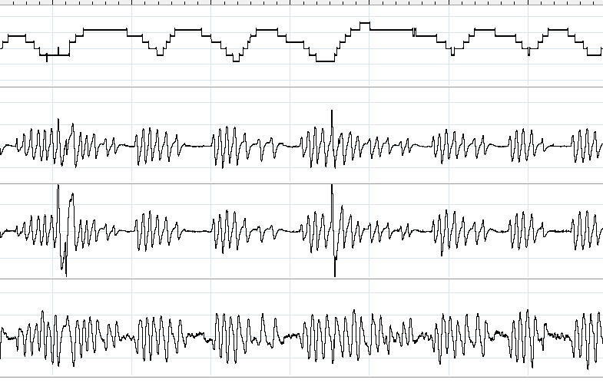
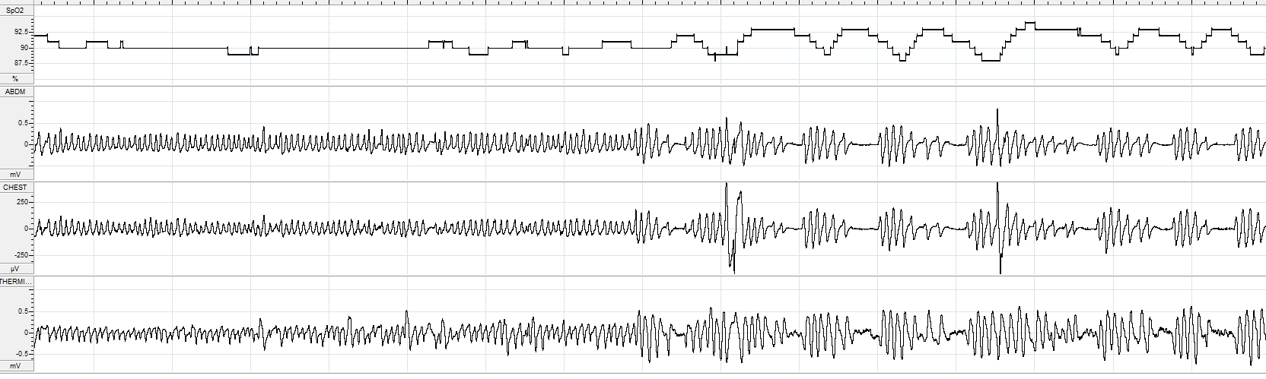
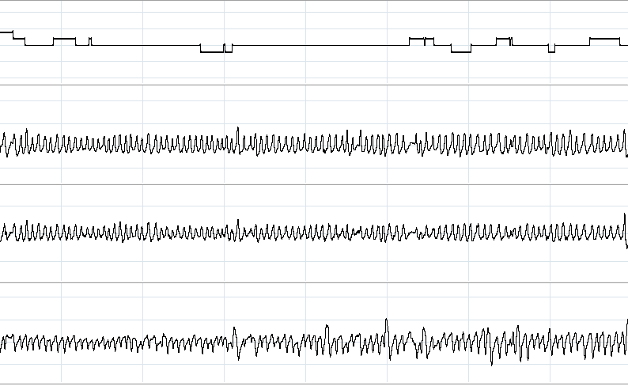
Breathing stabilizes and apnea events are significantly reduced when phrenic nerve simulation is being delivered in this example¹
1 Min Intervals
Note: This is an individual patient example and does not provide any indication, guide, warranty or guarantee as to the response other patients may have to the therapy
Oxygen Saturation
Oxygen Stabilizes
Central Apnea Events
Abdominal Belt
Thorax Belt
Airflow
Therapy Off
Therapy On
1 Costanzo MR, et al., J Card Fail. 2015;21:892-902
MAF1937 rev F
Notes:
Shown here are the effects of stimulation on the breathing pattern. Oxygen is stabilized and central events resolve with stimulation.

Slide 37
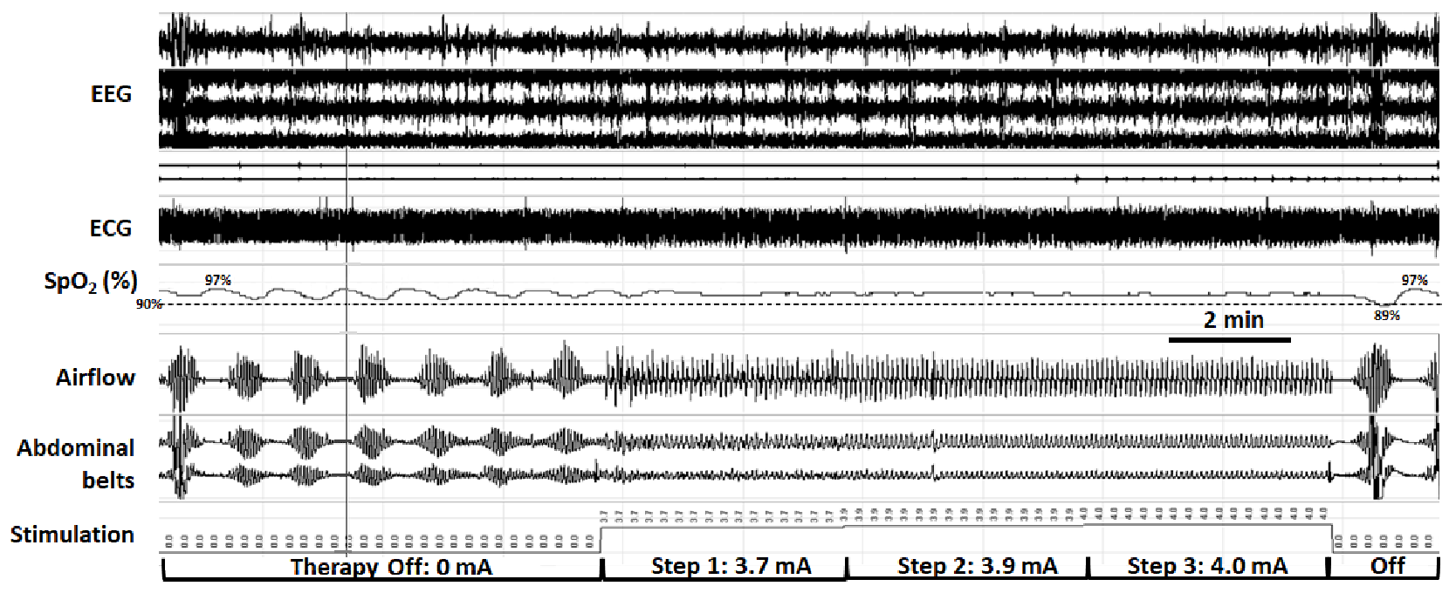
Step-wise increases in stimulation captures ventilation and stabilizes breathing pattern
Note: This is an individual patient example and does not provide any indication, guide, warranty or guarantee as to the response other patients may have to the therapy
Automatic step-wise increases in stimulation amplitude stabilize tidal airflow, respiratory effort and oxyhemoglobin saturation as ventilation is captured progressively
A period of step-wise increases in phrenic nerve stimulation amplitude (middle segment) is bracketed by periods off stimulation. Automatic step-wise increases in stimulation amplitude stabilize tidal airflow, respiratory effort and oxyhemoglobin saturation as ventilation is captured progressively.
MAF1937 rev F
Schwartz AR, et al. J Clin Sleep Med. 2020;16(5):817–820.
Notes:
Shown here is a PSG from a Cheyne-Stokes/CSA patient. When the patient first goes to sleep, there is a window prior to activation. Then the device will come on at the “minimum stimulation” level. Every 2 minutes, the device will see if the patient is breathing at the programmed rate and will increase the output if the breathing rate is different. This happens until the patient is breathing at the correct rate or the patient has reached the “maximum programmed stimulation level”.
One the patient is breathing at the set rate or reached the maximum level, the patient will stay at that rate until something changes in the system such as a role. As shown here, rolling to a different quadrant suspends therapy for up to 5 minutes (based on programming) and then the process restarts.

Slide 38
Typical remedē therapy follow-up schedule
6 weeks post-implant
1-3 months
Every 3-6 months
Therapy Activation
Acclimation / Therapy Titration
Long-Term Follow-Up
Therapy is activated 6 weeks after implant during a follow-up office visit
Patient acclimation period as therapy is customized to maximize efficacy while maintaining patient comfort
Programming checks every 3-6 months to optimize therapy. Physician may order a sleep study to help optimize.
MAF1937 rev F
MKT1674, Rev P
Notes:
Therapy is activated at approximately 6 weeks after implantation. Over the next 3 months, typically 2-4 visits are required to program the patient for their individual needs. Long term, patient are checked every 6 months or sooner if needed.

Slide 39
remedē reports provides a window to the care of the patient
Report gives an overview
Programmed settings and battery
Sleeping position
Patient activity
Lead integrity
Therapy duration
Therapy efficacy/respiratory stability
Some devices have the capability to give up to 6 months of data
DRēAM View is available in EL/EL-X Systems
MAF1937 rev F

Slide 40
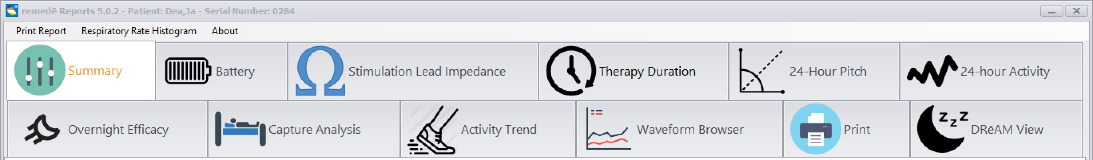
remedē Reports | Patient Data Review
Easily navigable bar at the top of the programmer to find data using 11-12 selectable tabs that allow for detailed review of collected diagnostic data
*Note: DRēAM View tab is only present when overnight waveform data is available.
MAF1937 rev F
Notes:
The remede programmer contain specialized diagnostic reports for the remede System.
Here is an image of all the reports displayed within remede reports.
There are 11-12 selectable tabs that allow for detailed review of collected diagnostic data. We will cover a few of these today, but detailed training is available as well.

Slide 41
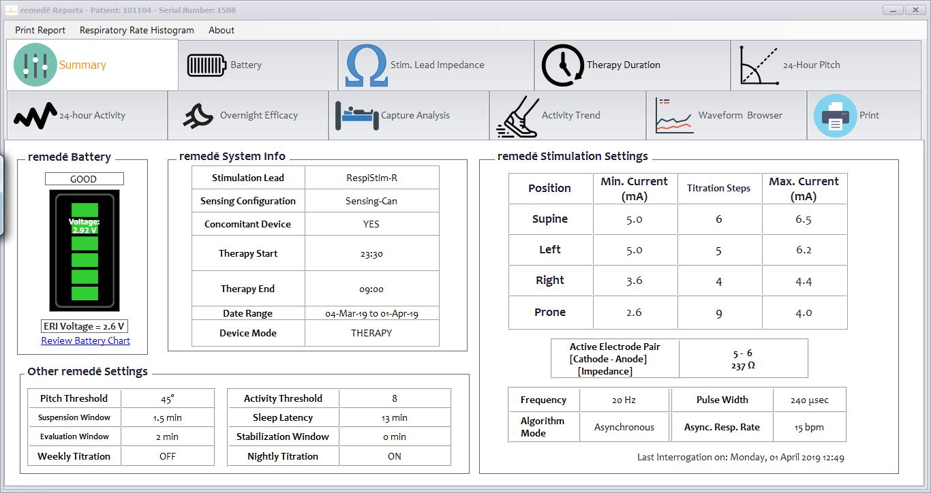
remedē Reports | Summary
The Summary tab contains an overview of the remedē IPG including battery status, system information, stimulation and other relevant settings
Battery status display with color indicator bars to help guide monitoring frequency
System information with relevant therapy configuration and schedule
Detailed stimulation settings for each sleeping posture
MAF1937 rev F
Notes:
Shown here is the Summary tab which contains an overview of the battery status, system information, stimulation settings and any other relevant information we may need to know while reviewing the remede reports. On the left we have battery status which is color coordinated to help guide monitoring frequency.
Next to that is the remede system information which contains the start and stop time and data range for the selected remede reports.
To the right of that we have the stimulation settings that are categorized by sleeping posture.

Slide 42
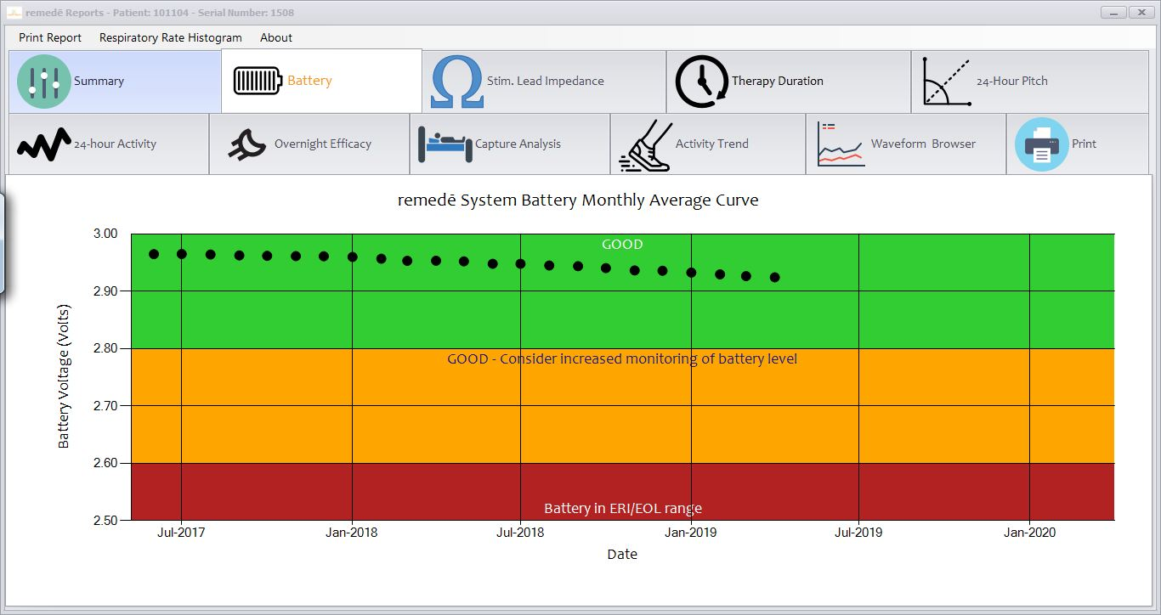
remedē Reports | Battery
The Battery tab contains a long-term trend of monthly average remedē IPG battery voltage measurements
Green (>2.80V) indicates a good battery and normal routine follow-up frequency is recommended
Yellow (2.80 – 2.60V) indicates a good battery status but a more frequent follow-up frequency is recommended
Red (<2.60V) indicates battery replacement is required
MAF1937 rev F
Notes:
The battery tab which contains the long term trend of monthly average of the pulse generator battery voltage measurements.
Any battery data point in the green represents a battery voltage that is above 2.80V Indicating good battery status and normal routine follow up frequency.
Any battery data point in the yellow represents a battery voltage that is between 2.80-2.60v indicating still good battery status but a more frequent follow up frequency is recommended.
Lastly any data point in the red is a battery voltage < 2.6 which indicates battery replacement is required.
Each data point represents one month.

Slide 43
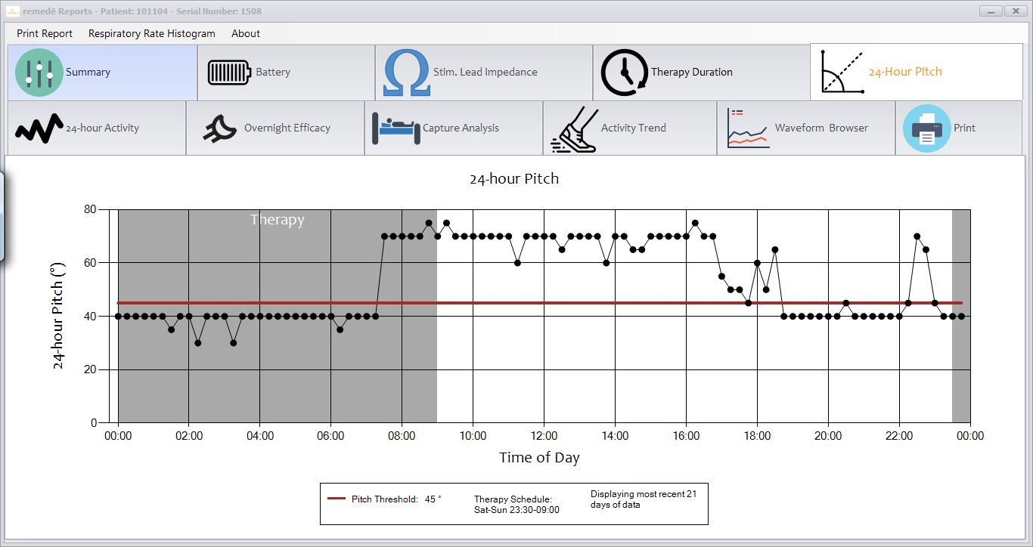
remedē Reports | 24-hour Pitch
Shaded portion indicates programmed therapy delivery time
Therapy is delivered during this time only when the pitch is below the programmed Pitch Threshold (red line)
MAF1937 rev F
Notes:
The 24-hour pitch graph contains the 21 day trend of the median daily pitch measurements over a 24 hour window.
The y axis displays pitch, x axis displays a 24 hour time window.
The grey shaded portion is based on the patients therapy start/stop window. Each dot represents the patients pitch average during a 15 minute window.
The red line demonstrates the patient’s pitch/sleeping posture. Therapy will activate only when the device is below the red line and in the therapy window (grey area).

Slide 44
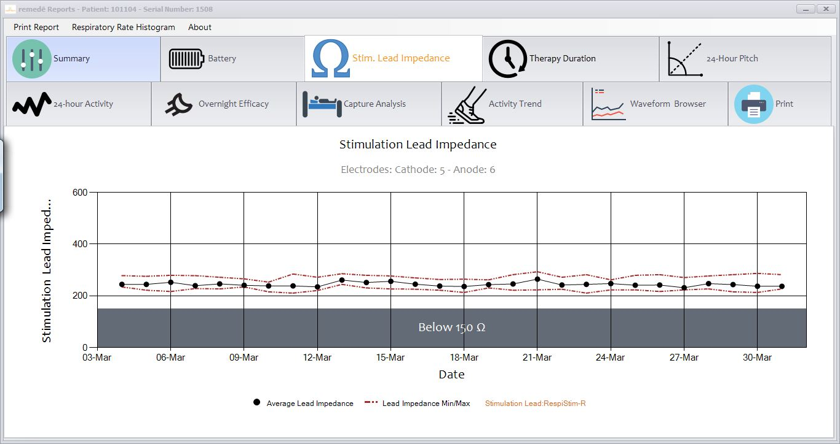
remedē Reports | Stimulation Lead Impedance
The Stim Lead Impedance Tab contains a recent trend of average, minimum, and maximum stimulation lead impedance measurements
Average impedance ranges:
Respistim R: 150 - 500 Ω
Respistim L: 500 - 1500 Ω
MAF1937 rev F
Notes:
The stimulation lead impedance graph contains a recent trend of average, minimum, and maximum stimulation lead impedance measurements.
The left lead which sits in a smaller blood vessel and has closer contact therefore the average lead impedance range of 500-1500 ohms.
The right lead which sits in a bigger blood pool, the Right bracheocheplic vein has an average lead impedance range of 150-500 ohms.
This graph should demonstrate stability. If there is a sudden change or it is out of range, it could indicate lead dislodgement, fracture, or improper lead connection.

Slide 45
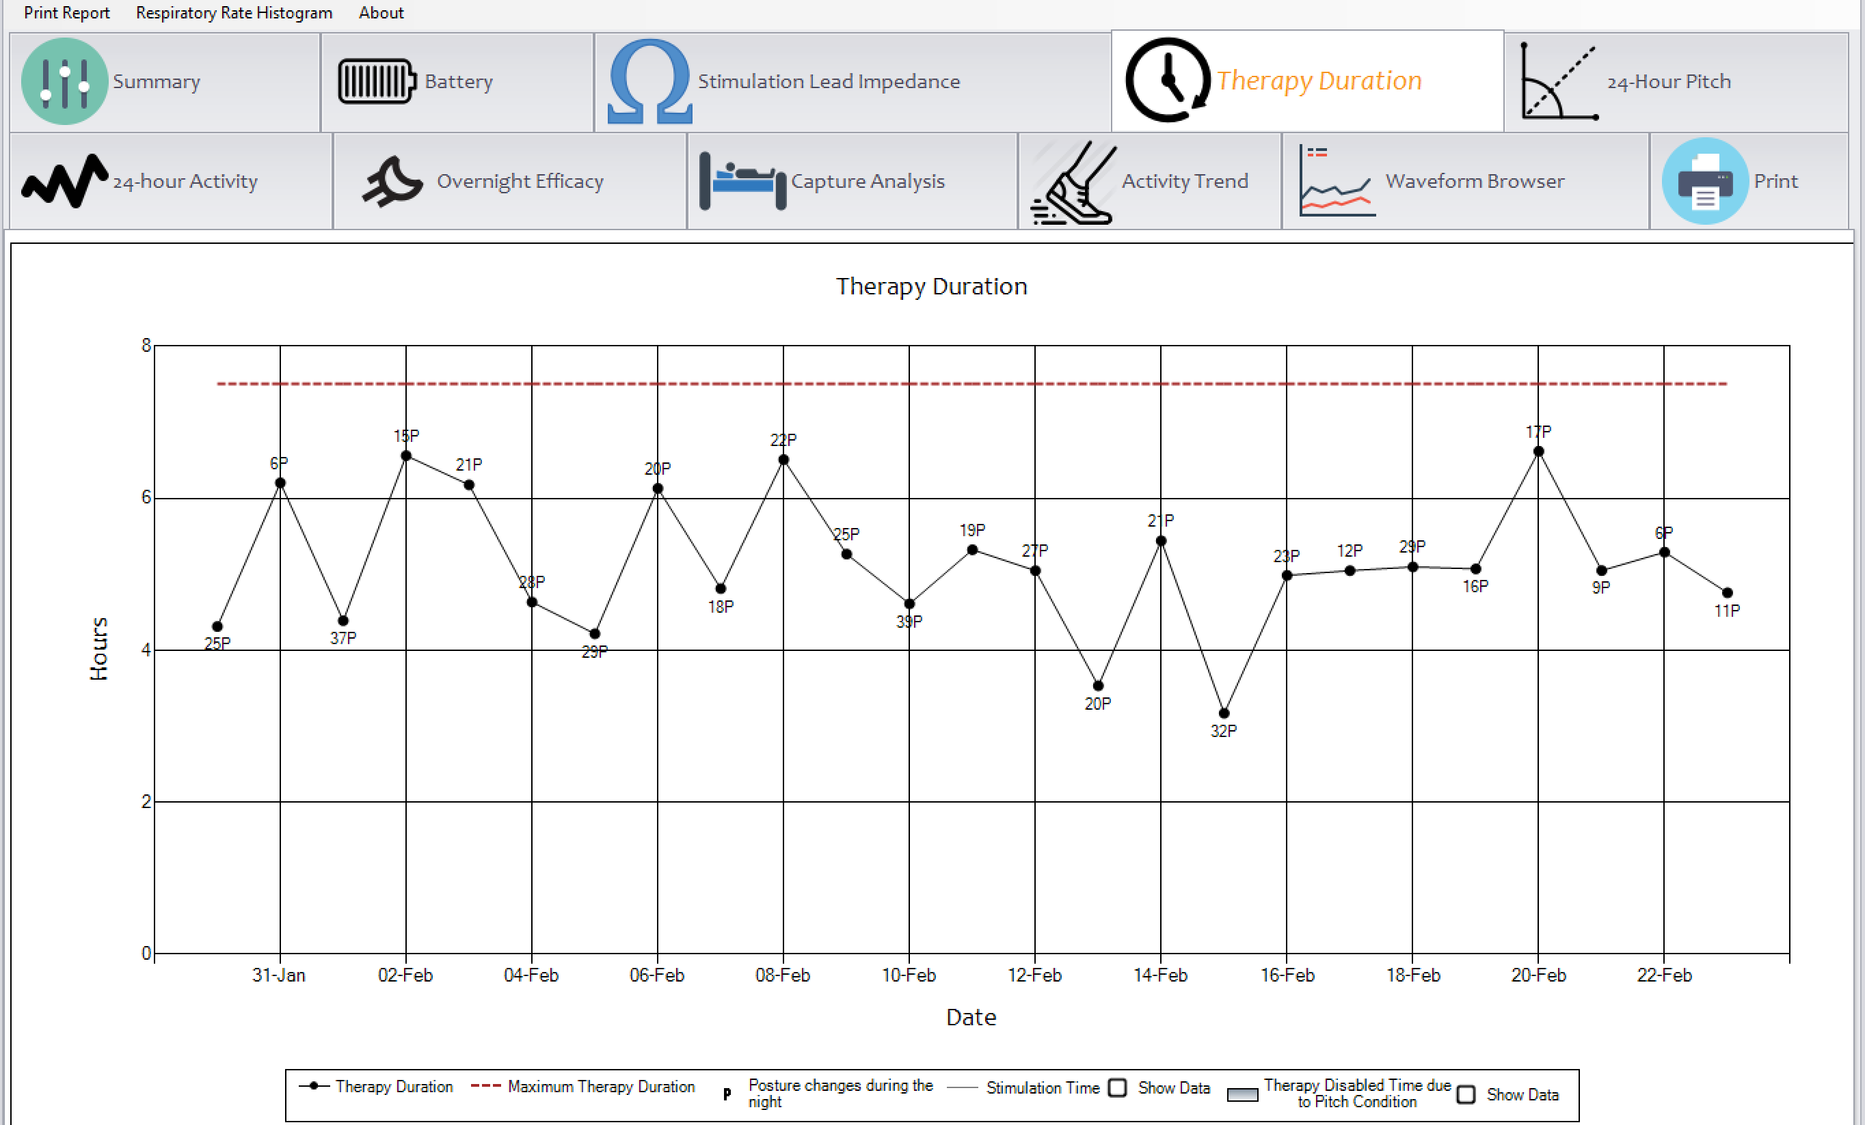
remedē Reports | Therapy Duration
The Therapy Duration tab contains a trend of the most recent daily therapy durations
Daily therapy duration may be less than the maximum available
Late to bed/early to rise
Therapy disabled due to activity or pitch
Includes detail to help determine if reduced therapy is due to sleep hygiene or programmed settings
Each data point contains a number followed by an A (activity) or P (pitch) indicating a count of related suspensions
MAF1937 rev F
Notes:
This graph demonstrates the amount of therapy a patient receives each night. Additional graphs on this page can give details as to whether a short therapy duration is due to pitch issues or activity.

Slide 46
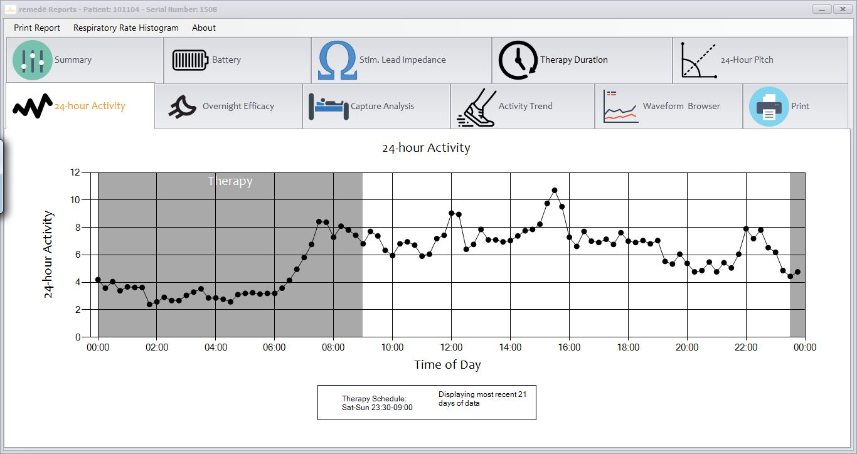
remedē Reports | 24-hour Activity
The 24-hour Activity tab contains a 21-day trend of average daily activity over a 24-hour window
Shaded portion indicates programmed therapy delivery time
MAF1937 rev F
Notes:
Much like the 24 hour pitch, this is the 24 hour activity graph
This graph can aid in understanding the patient’s sleep cycle.

Slide 47
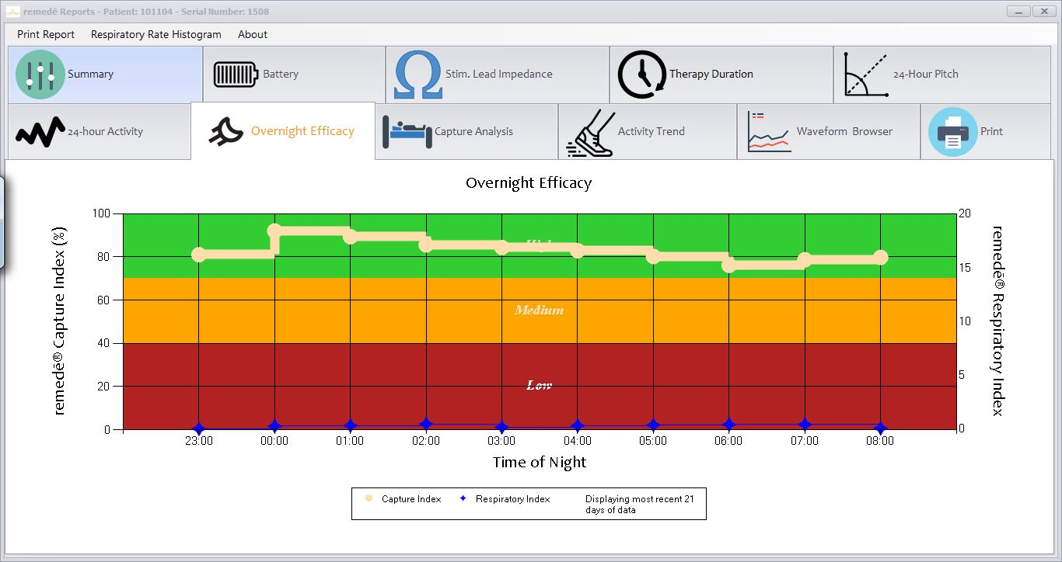
remedē Reports | Overnight Efficacy
The Overnight Efficacy tab contains a 21-day average therapy efficacy graph per hour of delivered therapy with both the remedē Capture Index and the remedē Respiratory Index
The remedē Capture Index (Tan line) indicates the average percentage of breaths that are synchronized to the delivery of remedē therapy
Good (Green), Medium (Yellow), and Low (Red) ranges correspond to the relative effectiveness of currently programmed stimulation settings
The remedē Respiratory Index (Blue points) indicates the average number of remedē observed apneas per hour of therapy
MAF1937 rev F
Notes:
Remede reports can give an overview of therapy efficacy.
Overnight efficacy graph looks at a 21 day average therapy efficacy graph per hour of delivered therapy and displays the. remede capture index and remede respiratory index.
Remede capture index indicates the average percentage of breaths that are synchornoized to the delivery of remede therapy.
The respiratory index is displayed by the blue stars and indicates how many 10 second pauses per hour

Slide 48
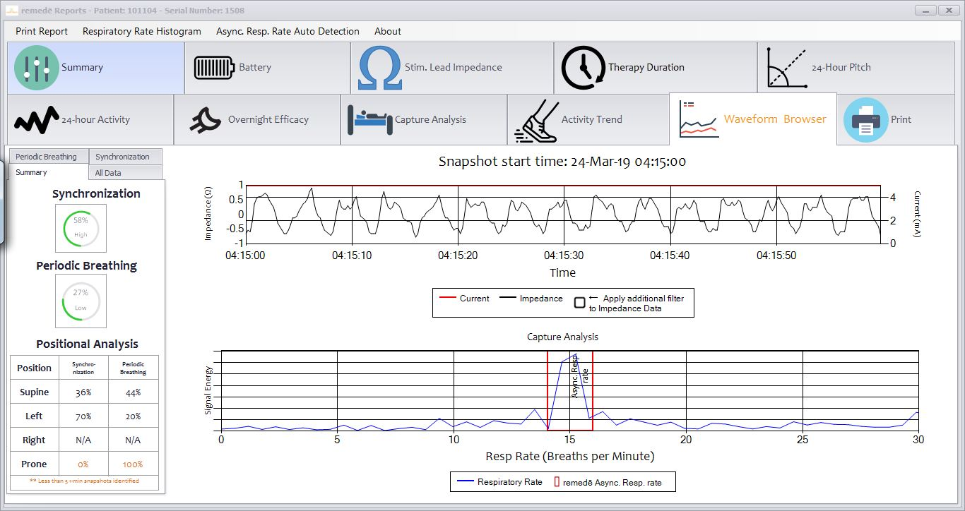
remedē Reports | Waveform Browser
The Waveform Browser tab contains respiratory waveform data organized by evidence of synchronization or remedē periodic breathing and a summary of positional therapy efficacy
MAF1937 rev F
Notes:
The Waveform Browser demonstrates the respiratory signal and classifies all 1-minute respiratory waveform snapshots (collected every 15 minutes during therapy time) according to evidence of Synchronization or Periodic Breathing.

Slide 49
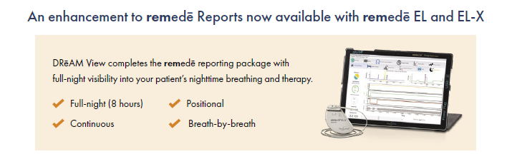
What is DRēaM View?
DRēaM View is a full-night, continuous, breath-by-breath visibility into a remedē patient’s breathing.
DRēAM View provides up to 8 hours of continuous waveforms that can be reviewed for breath stability, sleep position and stimulation current.
MAF1937 rev F
Notes:
Lastly, we have dream view dream view isa full night continuous breath by breath look at the patients breathing at night. It provides 8 hours of continuous waveforms that can be review for breath stability, sleep position and stimulation current. As mentioned Dream view within the EL/EL-x system records 480 minutes vs our gen 1 device which recorded 75 minutes.

Slide 50
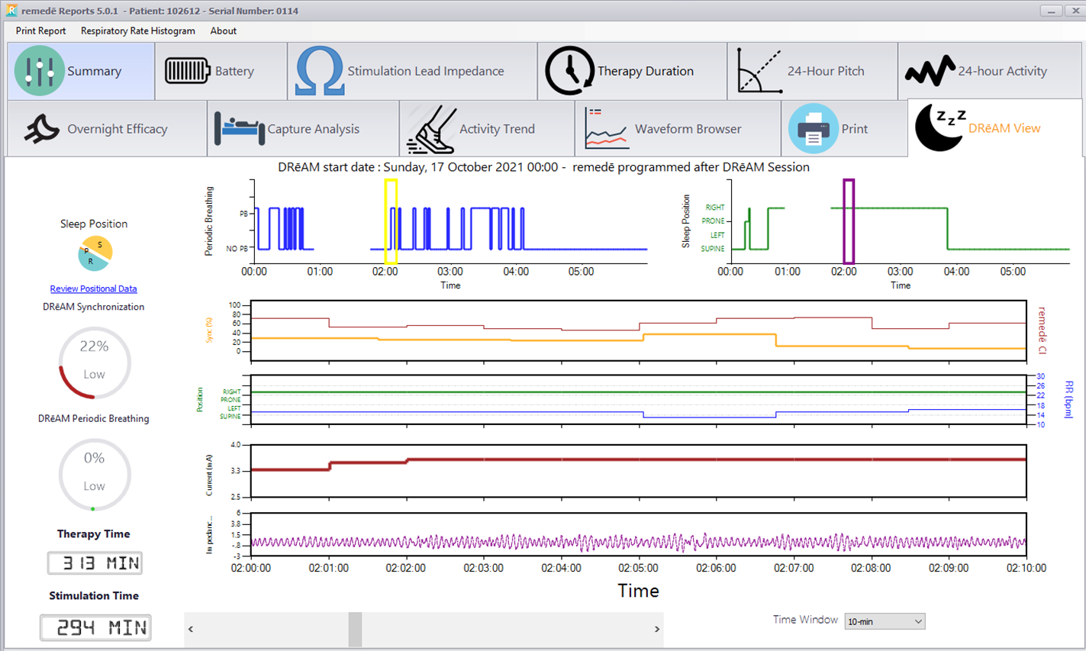
DRēaM View Channel Overview
Periodic Breathing & Positional Overview
*Capture Index % (red) Synchronicity % (yellow)
Sleep Position (green) *Breathing Rate (blue)
Stimulation Current (mA)
*Respiratory Sensing
(TI waveform)
Time Window (increments) and slider bar
* Capture Index %, Breathing Rate (RR), and “Filter Sensing Data” must be added manually (press and hold)
MAF1937 rev F
Notes:
Dream View collects the all respiratory signals for a single night and combines this with stimulation level and body position It can be examined similar to a HST and can be gathered between each visit.

Slide 51
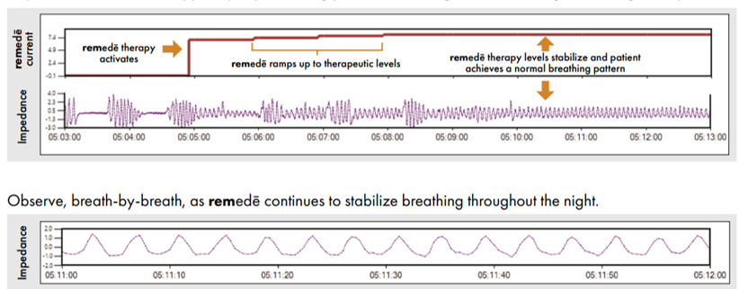
When to use DRēaM View
DRēaM View is a great way to show remedē in action!
Pinpoint how remedē therapy ramps up and establishes a more regular rhythm
remedē therapy levels stabilize and patient achieves a more normal breathing pattern
Note: This is an individual patient example and does not provide any indication, guide, warranty or guarantee as to the response other patients may have to the therapy.
MAF1937 rev F
Notes:
Top image shows breathing waveforms of a 10 minute window. The red line represents stimulation current. As you can see, as we progress in our 10 minute window, we go from apneas being present during no stimulation current, hypopneas as the stimulation current is increasing and towards the end of the 10 minute window we have synchronization/ normal breathing pattern. Bottom image is a zoomed in one minute version.

Slide 52
Conclusions
The remedē System is placed in an outpatient procedure by an electrophysiologist
The device activates automatically at night when the patient is in a sleeping position
remedē Reports include diagnostic information to help manage long term patient care
MAF1937 rev F

Slide 53
remedē® System Clinical Data
MAF1937 rev F

Slide 54
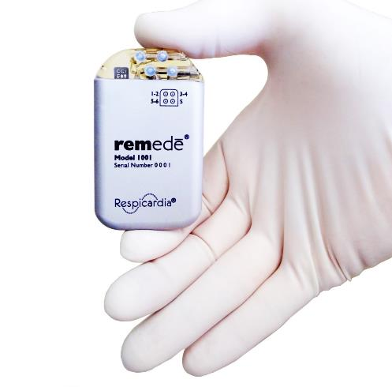
History of Transvenous Phrenic Nerve Stimulation: Studies Prior to Approval
Safety Study | 4 Subjects
Proof of Concept | 10 Subjects
Lead and Algorithm Development | 41 Subjects
Acute Feasibility (Control Night vs Therapy Night) | 16 Subjects
Chronic Safety Study | 8 Implanted Subjects
Pilot Study - Chronic Feasibility | 49 Implanted Subjects
Pivotal Trial – IDE Study | 147 Implanted Subjects
The remedē pivotal trial is the largest randomized trial thus far in CSA patients to meet its endpoints and show benefit
All chronic studies have shown consistent improvements in sleep metrics and quality of life
Abraham et al. JCHF 2015;5:360-369. Costanzo et al. J Card Fail 2015;21:892-902. Costanzo et al. The Lancet 2016;388:974-82.
Costanzo et al. Am J Cardiol 2018 ;131 :1400-1408. Jagielski et al., Eur J Heart Fail 2016 DOI: 10.1002/ejhf.593. Ponikowski et al. Eur Heart J 2012;33:889-894.
Zhang et al. Clin Respir J 2015; DOI:10.1111/crj. 12320. Zhang et al. Chest 2012; 142:927-934.
PMA FDA Summary of Safety and Effectiveness Data, PMA P160039
MAF1937 rev F
Notes:
The remedē System began development in 2007 and received approval in 2016. There have been a series of clinical studies in the path to approval that all delivered similar results including improvement in AHI, oxygen and quality of life.

Slide 55
The remedē System Pivotal Trial Study design
Prospective, multi-center, randomized controlled trial
Baseline criteria for moderate to severe CSA was based on PSGs scored by a blinded core laboratory
AHI ≥ 20
CAI at least 50% of all apneas with at least 30 central apnea events
Obstructive Apnea Index ≤ 20% of the total AHI
ENDPOINT | DESCRIPTION | POPULATION
Primary Effectiveness (6 months) | Comparison of the proportion of subjects with ≥50% reduction in AHI between treatment and control | Intention to Treat (ITT)
Primary Safety (12 months) | Freedom from serious adverse events associated with implant, the remedē system, or delivered therapy | Intention to Treat
Secondary Hierarchical (6 months) | Central Apnea Index (CAI) Apnea Hypopnea Index (AHI) Arousal Index (ArI) Rapid Eye Movement (REM) Patient Global Assessment (PGA) Oxygen Desaturation Index 4% (ODI4) Epworth Sleepiness Scale (ESS) | Per-protocol
Costanzo MR, et al., J Card Fail. 2015;21:892-902.
MAF1937 rev F
Notes:
The remedē System Pivotal trial was a prospective, multi-center, randomized controlled trial with blinded endpoints by an independent core lab. The entry criteria included an AHI of at least 20 events/hour and central apneas at least 50% of all apneas. Hypopneas were not classified as central or obstructive during the study. For the purposes of the clinical study, obstructive apneas were limited to no more than 20% of the total AHI.
The primary endpoint was a comparison of the proportion of subjects with at least a 50% reduction in AHI between treatment and control. The secondary endpoints were analyzed in the per protocol population in a hierarchical manner (i.e. each had to be met to analyze the next endpoint). Safety did not have a pre-set endpoint based on feedback from the FDA. Instead, all serious related adverse events were included in the risk/benefit discussion.

Slide 56
The remedē System Pivotal Trial Study design
Treatment
n=73
Therapy
On
Therapy
initiation visit
Primary effectiveness endpoint
Primary safety endpoint
Enrolled
n=151
Therapy ongoing
(follow-up every 3 months)
1 month
6 months
12 months
Control
n=78
Therapy
Off
Therapy
On
Former control group
Costanzo MR, et al. Am J Cardiol 2018;,121:1400-1408.
MAF1937 rev F
Notes:
Patients were considered enrolled at the time of implant and randomized to either therapy on or off. After six months, the control group was then activated, and patients were followed until the time of FDA approval (between 2 and 3 years).

Slide 57
The remedē System Pivotal Trial Baseline demographics
VARIABLE | TREATMENT (N=73) |  |  | CONTROL (N=78)
Age (years) | 65 | ± | 12 | 65 | ± | 13
Male gender | 86% |  |  | 92%
Body mass index (kg/m²) | 30.8 | ± | 5.3 | 31.3 | ± | 6.6
Ejection fraction (%) | 40.6 | ± | 12.8 (n=71) | 39.4 | ± | 12.2 (n=75)
Heart failure¹ (% [NYHA I / II / III / IV]) | 66% (13 / 44 / 44 / 0%) |  |  | 62% (25 / 42 / 33 / 0%)
Atrial fibrillation | 44% |  |  | 41%
Concomitant cardiac device | 42% |  |  | 42%
Apnea hypopnea index (events/hr) | 48.8 | ± | 19.3 | 43.7 | ± | 16.8
Central apnea index (events/hr) | 30.0 | ± | 18.0 | 26.6 | ± | 16.1
Epworth sleepiness scale (points) | 10.2 | ± | 5.2 | 9.5 | ± | 5.8
¹ Required the investigator to assign a NYHA Class at the Baseline physical exam. 58% of patients had an EF <= 45%.
Mean ± SD for continuous variables/Percent for categorical variables. All nominal p-values ≥ 0.075
Costanzo MR, et al. The Lancet 2016;388:974-82
MAF1937 rev F
Notes:
Patients were primarily recruited from cardiology practices using NOX-T3 for screening and then confirmed by PSG. Patients were on average 65 years old, male, with a slightly decreased ejection fraction. 64% of the patients had a diagnosis of HF and 42% had a cardiac implantable device (PM, ICD or CRT). The average AHI was 45 events/hour with approximately 30 central apneas per hour. Patients had an Epworth of 10 points; however, most patients had some symptoms of sleep apnea

Slide 58
The remedē System Pivotal Trial Clinical Trial Met all Primary and Secondary Endpoints
Change from baseline
Between group difference
Endpoint
Treatment
Control
Difference
p-value
Endpoint Met?
Primary endpoint
(n= 141⁵)
>50% reduction in AHI¹
51%
11%
41%
<.0001^{Δ}
Yes
CAI (events/hr)
-25.7 ± 18.0
-2.9 ± 17.7
-22.8 ± 17.8
<.0001†
Yes
AHI (events/hr)
-23.9 ± 18.6
1.1 ± 17.6
-25.0 ± 18.1
<.0001‡
Yes
ArI (events/hr)
-20.2 ± 18.9
-5.0 ± 18.1
-15.2 ± 18.5
<.0001‡
Yes
Secondary endpoint
(n= 131⁵)
% of sleep in REM
1.8 ± 8.2
-0.6 ± 7.8
2.4 ± 7.9
.0244†
Yes
QOL – PGA²
% patients w/ marked or moderate improvement
60%
6%
55%
<.0001^{Δ}
Yes
ODI4 (events/hour)
-19.1 ± 18.4
3.6 ± 17.3
-22.7 ± 17.8
<.0001†
Yes
QOL – ESS³
ESS score
-3.6 ± 5.6
+0.1± 4.5
-3.7 ± 5.0
<.0001†
Yes
Safety
91% (CI: 86%,95%) freedom from serious adverse events associated with the implant procedure, device, or the delivered therapy at 12 months
1 Primary endpoint is the proportion of subjects achieving ≥50% reduction in AHI
2 PGA = Patient global assessment
3 ESS = Epworth Sleepiness Scale, an 8-question assessment used to assess sleepiness
4 Costanzo et al. Lancet 2016;388:974-82; Goldberg L et al. J Cardiac Fail 2017;23:S15.
5 For primary endpoint, n=68 for treatment and n=73 for control; for secondary endpoints, n=58 for treatment and n=73 for control
Δ Fisher’s Exact Test.
† Mann-Whitney test for difference in change from baseline between groups.
‡ t-test for difference in change from baseline between groups.
Costanzo MR, et al. The Lancet 2016;388:974-82
MAF1937 rev F
Notes:
The study met its primary endpoint and all seven of its hierarchically tested secondary endpoints. There was a 41% difference in the patients achieving a 50% reduction in AHI. This remained regardless of the % reduction of AHI.
The CAI was reduced by over 90% which was the mechanism of action and led to a reduction in AHI of 25 events/hour and improvement in ODI4% of 23 events/hour. Importantly, sleep quality was improved as demonstrated by a 44% improvement in the arousal index and an improvement % of time in REM sleep. This improvement in sleep quality led to an improvement in QoL as measured by the patient global assessment. Daytime sleepiness improved by 3.7 points.

Slide 59

Symptoms and Quality of Life Improved with 6 months of remedē System Therapy¹
Improvement in Epworth Sleepiness Scale
Patient Global Assessment
Willingness to repeat procedure
p < 0.0001
Marked or moderate improvement
No change
Mild improvement
Worsened
Improved
6%
95%
Treatment (N=58)
Control
(N=73)
No change/worse
ESS Mean Change from Baseline (points)
[95% confidence interval]
Per Protocal Population * One patient did not complete the PGA assessment at 6 months.
>2.5 change in ESS is considered clinically meaningful²
Demonstrated clinically significant improvement in daytime sleepiness
79% of patients had an improvement in quality of life with the remedē System
95% of patients reported they would
“elect to have the medical procedure again”
Costanzo et al. Lancet 2016;388:974-82. 2) Patel S, Kon SSC, Nolan CM, et al. The Epworth Sleepiness Scale: minimum clinically important difference in obstructive sleep apnea. Am J Respir Crit Care Med. 2018;197(7):961–963
Costanzo 2018. Am J Cardiol. 2018 Jun 1;121(11):1400-1408
MAF1937 rev F
Notes:
After six months of treatment, TPNS showed a clinically significant improvement in daytime sleepiness, quality of life as measured by patient global assessment and 95% of patients described a willingness to have the device implanted again.
This study was not blinded as patients do feel the stimulation, but most of the metrics were considered above the placebo effect.

Slide 60
Sustained Improvement in AHI with Transvenous Phrenic Nerve Stimulation
Apnea Hypopnea Index
Paired at 5 years
Median AHI
42
17
PSG
PSG
35 PSG+7 PG
Median
Events/hr
Median
Events/hr
Visit
Visit
Baseline 5 Year
N
131
115
101
50
42
N
42
42
Costanzo et al. Nature Sci Sleep 2021;13:515-526
Note: Sum of component medians does not add up to AHI.
Median change [IQR]: -22 [-42, -7] P<.001
MAF1937 rev F
Notes:
Following FDA approval, a subset of patients were re-enrolled in a post-approval study and followed for 5 years. The reduction in AHI was maintained through 5 years with the central events almost completely resolved.

Slide 61

Sustained Improvement in Sleep Architecture with remedē System Therapy Through 5 Years
Shift away from light stage sleep (N1) to more deeper stage sleep (N2 - REM)
Paired at 5 years
Sleep Stages
Sleep Stages
Note: Sum of medians at a visit does not add up to 100%
Costanzo MR, Javaheri S, et al. Transvenous Phrenic Nerve Stimulation for Treatment of Central Sleep Apnea: Five-Year Safety and Efficacy Outcomes. Nat Sci Sleep. 2021;13:515-526
MAF1937 rev F
Notes:
Similar to the reduction in AHI, the improvement in REM sleep was maintained through 5 years.

Slide 62
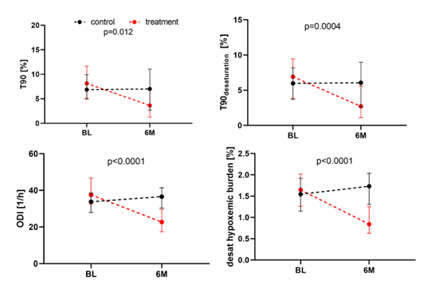
Improvement in Oxygen Metrics and Hypoxic Burden with Transvenous Phrenic Nerve Stimulation remedē System Pivotal Trial Data
Baumert et al. Int J Cardiol 2023;378:89-95.
MAF1937 rev F
Notes:
Another Post-hoc analysis by Baumert et al. looked at hypoxic burden and demonstrated a significant improvement in oxygenation utilizing several different metrics.

Slide 63
The remedē System Pivotal Trial demonstrated a strong safety profile
91% (CI: 86%,95%) freedom from serious adverse events associated with the implant procedure, the remedē® System, or the delivered therapy at 12 months¹
All related serious adverse events resolved without any long-term sequelae¹
No deaths related to the procedure, system or therapy¹
97% implant success rate, including the 42% of subjects that already had a concomitant cardiac device¹
The remedē System has shown a 7-15% lead revision rate in commercial experience²
1 Costanzo MR, Ponikowski P, Javaheri S, et al. Randomised Controlled Trial of Transvenous Neurostimulation for Central Sleep Apnoea. The Lancet 2016;388:974–82.vv
2 Internal data and analysis; 2018-2023
MAF1937 rev F
Notes:
TPNS delivered a strong safety profile with 91% freedom from serious adverse effects. No adverse effect caused any long-term harm and there were no deaths related to the procedure, system or therapy.
The primary risk of implantation is due to lead movement in the 7-15% range. Education of the patient from the time they consider TPNS as an option is important to decrease this risk. Patients should keep the arm on the side of the device (typically right) below their shoulder for at least six weeks. It is recommended that they wear a sling for at least 48 hours if possible.

Slide 64
remedē System Pivotal Trial Safety Events
Primary Safety Endpoint:
Serious Adverse Events Related to Implant, Procedure, remedē System, and/or Delivered Therapy through 12 Months
Intention to Treat
(N=151)
Any serious related AE | 13 | 9%
Lead Dislodgment¹ | 2 | 1%
Impending Pocket Erosion | 2 | 1%
Implant Site Infection | 2 | 1%
Concomitant Device Interaction | 1 | 1%
Extra Respiratory Stimulation² | 1 | 1%
Lead Component Failure | 1 | 1%
Lead Displacement³ | 1 | 1%
Implant Site Hematoma | 1 | 1%
Non-Cardiac Chest Pain | 1 | 1%
Elevated Transaminase | 1 | 1%
n (Events)
% (Patients)
Costanzo MR, Ponikowski P, Javaheri S, et al. Randomised Controlled Trial of Transvenous Neurostimulation for Central Sleep Apnoea. The Lancet 2016;388:974–82.
1. Lead dislodgement: when the stimulation lead pulled out of the target vessel and required the lead to be repositioned or replaced in order to deliver therapy
2. Extra-respiratory stimulation: discomfort or feeling delivered therapy in area remote from the diaphragm
3. Lead displacement: when the stimulation lead remained in the target vessel but electrode position did not allow effective therapy delivery
Costanzo MR, et al. The Lancet 2016;388:974-82
MAF1937 rev F
Notes:
Seen here are the individual AEs seen in the clinical trial. As noted, none were greater than 1% through 12 months. Note that lead repositioning rate seen in the prior slide could occur from several different AEs above and was 9% through 5 years in the clinical trial

Slide 65
Analyses in Specific CSA Populations
MAF1937 rev F

Slide 66
Sleep and Quality of Life in HF Patients Post-hoc Analysis of the remedē System Pivotal Trial
Post-hoc analysis showed improvements from baseline at 12 months¹
Sleep metrics (All p= or < 0.001)
Apnea Hypopnea Index (AHI)
Central Apnea Index (CAI)
Oxygen Desaturation Index (ODI)
Arousal Index
% of sleep in REM
ODI4 (events/hour)
% of sleep with O2 saturation < 90%
Epworth Sleepiness Scale
3.1 ± 4.7 point improvement from baseline (p<0.001)
Minnesota Living with Heart Failure
6.8 ± 20.0 point improvement from baseline (p=0.005)
Patient Global Assessment
Marked or moderate improvement
No change
Mild improvement
Worsened
Improved
No change/worse
Similar results in quality-of-life improvements in heart failure cohort as broader patient population²
Per protocol with heart failure
MAF1937 rev F
1 Constanzo et al., European Journal of Heart Failure 2018; doi:10.1002/ejhf.1312.
2 Goldberg et al., J Cardiac Fail 2017;23:S15
Notes:
While only 64% of patients enrolled in the trial had HF, the subgroup was analyzed to determine the effect in this population. This subgroup had a similar improvement in sleep metrics to the full group including AHI, CAI, and oxygenation. In addition, daytime sleepiness improved, and one HF specific metric was measured Minnesota Living with Heart Failure. It showed a 6.8 point improvement (between ACE inhibitors and beta-blockers).

Slide 67
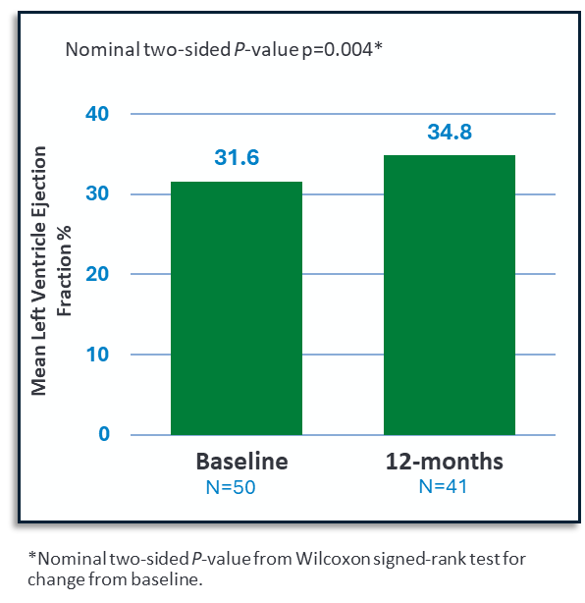
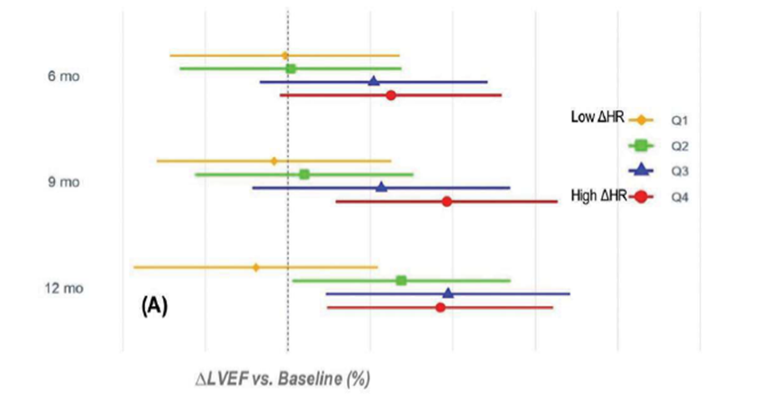
Changes in LVEF in the HF Treatment Group with TPNS Exploratory Analyses from the Pivotal Trial
Change in LVEF for treatment patients at 12-mo
(Subgroup with HF, EF≤45% and no permanent AF)¹
Change in LVEF Over Time Based on Change in HR following apneas at Baseline
Note: remedē is not indicated to treat, cure, prevent, mitigate or diagnose heart failure. These data represent unspecified secondary endpoints.
1 Costanzo et al. Eur J Heart Fail 2018; https://doi.org/10.1002/ejhf.1312 2 Azarbarzin et al. SLEEP 2025 http://doi.org/10.1093/sleep/zsaf085
MAF1937 rev F
Notes:
Ejection fraction showed a modest improvement in the Pivotal Trial
Following this, Azarbarzin analyzed change in ejection fraction based on changes in heart rate after apneas. They found that ejection fraction improvement was tied to a great change in heart rate following apneas. By 12 months, all groups had an improvement in EF except the lowest quartile. This may indicate that patients with more severe HF are less likely to see an improvement in EF.

Slide 68
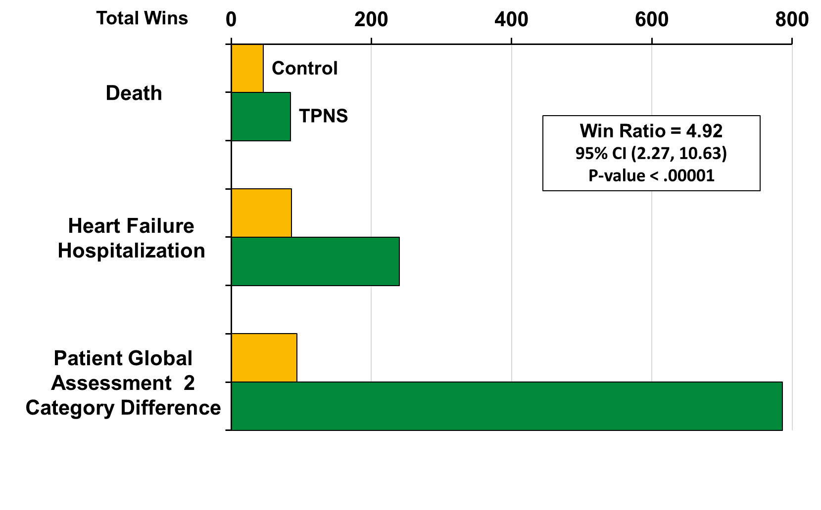
Evaluation of TPNS vs No Therapy in Patients with HF
A Post-hoc Win-Ratio Analysis of the remedē System Pivotal Trial
*remedē is not indicated to treat, cure, prevent, mitigate or diagnose heart failure. These data represent unspecified secondary endpoints. remedē has not been shown to provide a mortality benefit
Abraham et al. ESC Heart Fail 2024 doi: 10.1002/ehf2.15074
MAF1937 rev F
Notes:
In a post-hoc analysis, Abraham et al. looked at the HF data using a new statistical method, the win-ratio. This analysis compares each patient to every other patient which improves the power of small trials. This metric is being utilized for new implantable therapies in the cardiovascular space. Using this method, the was an overall clinical benefit to the remedē System utilized a hierarchical endpoint of death, HF hospitalization and QoL (using patient global assessment). This was driven by the QoL, but all 3 endpoints favored TPNS. As a post-hoc analysis this should be considered hypothesis generating for future clinical trials, but adds some confidence in the risk/benefit analysis of TPNS

Slide 69
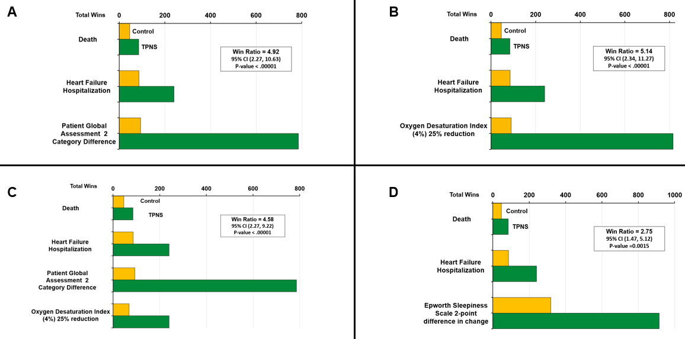

Evaluation of TPNS vs No Therapy in Patients with HF
A Post-hoc Win-Ratio Sensitivity Analysis of the remedē System Pivotal Trial
Abraham et al. ESC Heart Fail 2024 doi: 10.1002/ehf2.15074
MAF1937 rev F
Notes:
A number of sensitivity analyses were completed using ODI and ESS. All analyses continued to demonstrated the benefit of TPNS over no treatment.

Slide 70
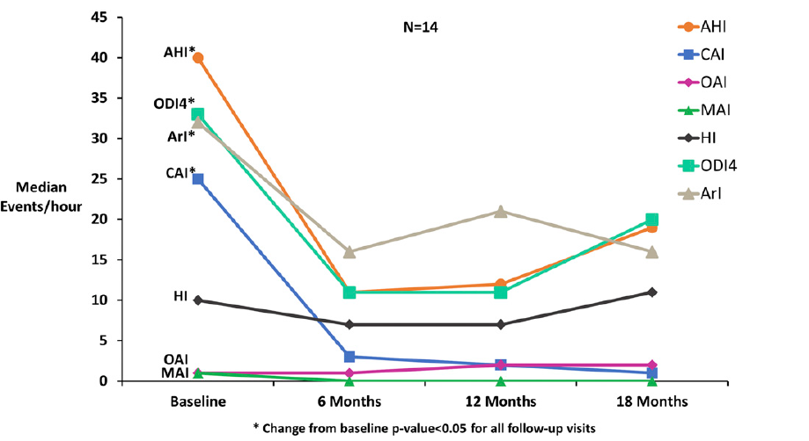
Idiopathic CSA: Changes in Sleep Metrics and Oxygenation in Patients remedē Pivotal Trial Data
Javaheri et al. J Clin Sleep Med. 2020;16(12):2099–2107.
MAF1937 rev F
Notes:
In a post-hoc analysis, Dr. Javaheri looked at the patients with no known cause of CSA and described as idiopathic by centers. This slide demonstrates similar improvements in all sleep metrics to the full cohort through 18 months. Improvements were also noted in ESS and QoL in this population.

Slide 71
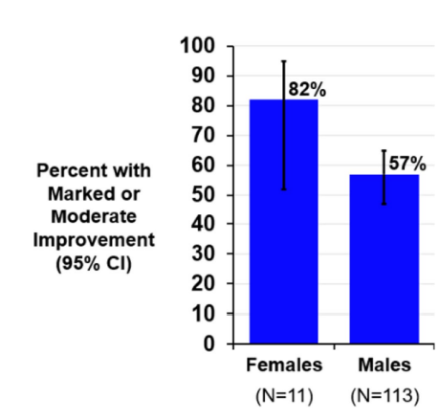
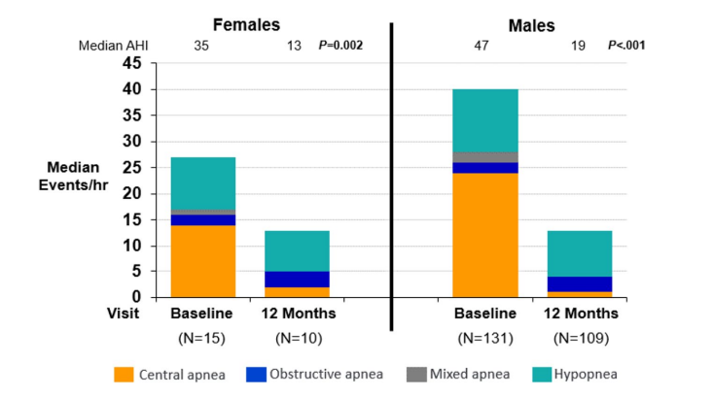
Effect of TPNS by Sex remedē System Pivotal Trial Data
Samii et. Sleep and Breathing 2024;28:168-171.
MAF1937 rev F
Notes:
One additional post-hoc analysis looked at TPNS in women. Although there were few females in this study (11), the results were similar to males and women had a higher percentage improvement in QoL (82% vs 57%).

Slide 72
Single Center Studies: Clinical Insights
MAF1937 rev F

Slide 73
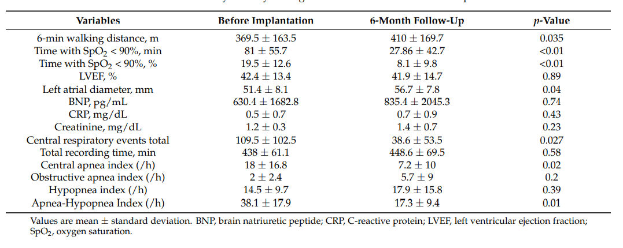
Changes in 6 min hall walk at 6 months A single center study
N=24
Potratz et al. J. Clin. Med. 2021, 10, 202. https://doi.org/10.3390/jcm10020202
MAF1937 rev F
Notes:
Several additional independent studies have added to the clinical data. This study from Bad Oeynhausen with Prof. Oldenburg demonstrated an improvement in 6 min hall walk test in 24 patients in an independent study. This study was utilized in the 2025 CSA guidelines for the improvement in CVD by TPNS.
Of note, time below 90% also improved along with sleep apnea metrics.

Slide 74
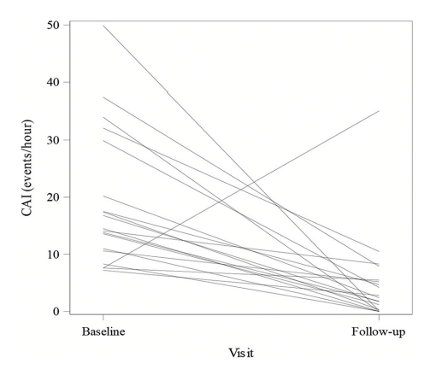
Changes in CAI with TPNS: a Single Center Study
Key findings in 22 patients
Demographics
36% had HF
36% had AF
AHI decreased by 21 events/hr
No change in OAI
ESS improved by 3.0 points
Safety
2 hematomas (resolved with tx)
1 lead reposition
Diaphragmatic discomfort that resolved with programming
Mease J, et al. Sleep and Breathing 2024;28:2089-89
MAF1937 rev F
Notes:
In this study from The Ohio State University, a retrospective analysis was done in 22 patients post approval of TPNS. Of note, only 36% of patients had HF. Improvements in CAI from 16 to 2, AHI and ESS were similar to the Pivotal trial and safety was strong with only 1 lead reposition due to lead movement.

Slide 75
Conclusions
The remedē system is supported by strong clinical evidence demonstrating its effectiveness in treating Central Sleep Apnea (CSA). Including:
Improvements in sleep metrics, including AHI, CAI, ODI4%, arousals, and REM sleep percentage
Improved Quality of Life and reduced daytime sleepiness
Comparable safety profile to other neurostimulation systems
Consistent efficacy in heart failure (HF) patients, with outcomes similar to those without HF
Potential benefit for patients with mixed sleep apnea, where therapies targeting both CSA and OSA may be appropriate
MAF1937 rev F

Slide 76
Patient Identification & Treatment Pathway
MAF1937 rev F

Slide 77
The FDA indication for remedē
FDA Indication:
Moderate to severe CSA in adult patients
Contraindication:
Active infection
MAF1937 rev F

Slide 78
Common questions on the indication
No requirement to have tried and failed other therapies for CSA
No upper limit of Apnea Hypopnea Index (AHI)
No upper limit of patient Body Mass Index (BMI)
No requirement that patients have exclusive or predominant central events
Encouraged, but not required to differentiate Central vs Obstructive Hypopneas
A NOTE ON DIFFERENTIATING HYPOPNEAS: How you handle hypopneas will have an important impact on which patients are determined to meet remedē criteria.
Whether your practice differentiates hypopneas is not critical
It is important that all hypopneas are not defaulted to OSA
MAF1937 rev F

Slide 79
Patients for remedē consideration
Consider remedē if…
Yes, for all sleep studies
CAHI ≥ 15
Does your practice differentiate hypopneas as central vs obstructive?
Differentiate hypopneas if CAI ≥ 5
Yes, but only if needed
CAHI ≥ 15
No
AHI ≥ 15 and CAI > OAI
CAHI = Central Apnea Hypopnea Index
MAF1937 rev F
MKT1812 Rev C

Slide 80
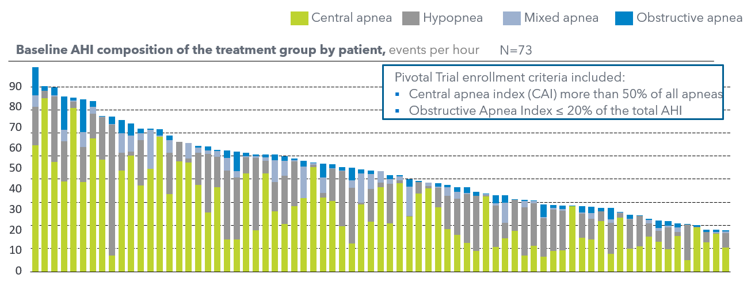
Composition of AHI at baseline for treatment arm subjects in the remedē Pivotal Trial
Costanzo MR, et al. The Lancet 2016;388:974-82
MAF1937 rev F

Slide 81
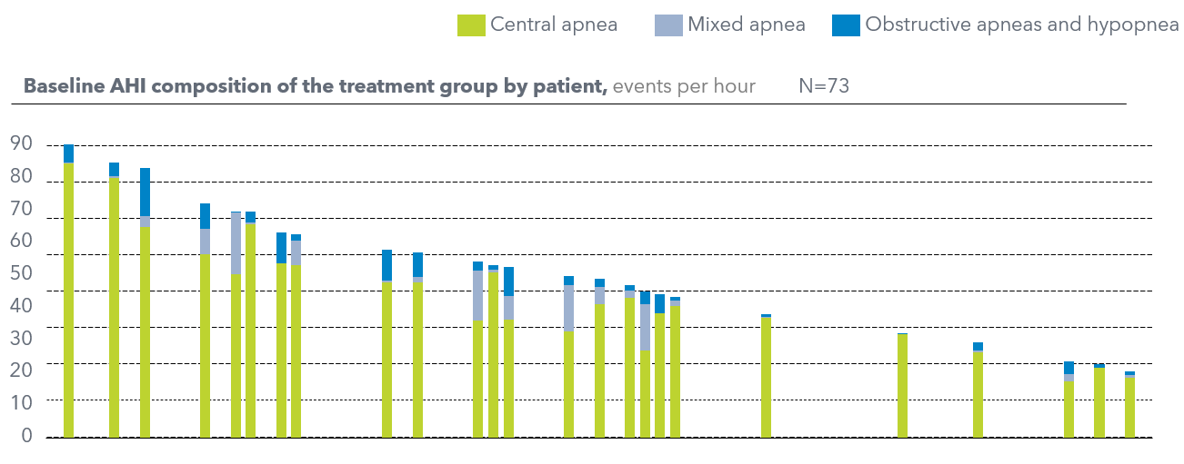
Hypopneas were unclassified in the Pivotal – counting all as obstructive would have excluded 66% of patients
Costanzo MR, et al. The Lancet 2016;388:974-82
MAF1937 rev F

Slide 82
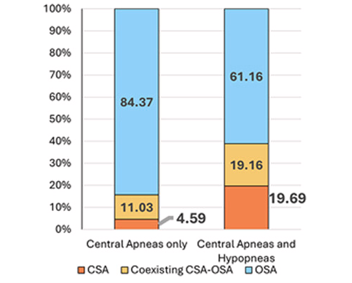
Differentiating hypopneas – or excluding them – is important for accurate identification of patients with CSA
CSA diagnosis was 4x higher using central hypopneas: “Only 4.59% of patients were defined as CSA when ignoring hypopnea classification, compared to 19.69% when accounting for hypopnea classification”
Study Highlights
4,431PSGs evaluated
55% had moderate to severe sleep apnea
CSA diagnosis was 4x higher (5% vs 20%) when differentiating hypopneas
1 Pépin, et al. Multidimensional phenotyping to distinguish among central (CSA), obstructive (OSA) and co-existing central and obstructive sleep apnea (CSA-OSA) phenotypes in real-world data, Sleep Medicine, Volume 124, 2024, Pages 426-433.
MAF1937 rev F

Slide 83
remedē in your treatment plan
Consider patients for remedē with a CAHI ≥ 15 who have:
Tried and cannot tolerate mask-based therapies, or
Persistently high AHI despite mask therapy, or
Heart failure with reduced LVEF (<45)
MAF1937 rev F

Slide 84
Thank you
QUESTIONS?
MAF1937 rev F

